Slide 1
Faculty/Staff Parking Portal Permit Purchase

Slide 2
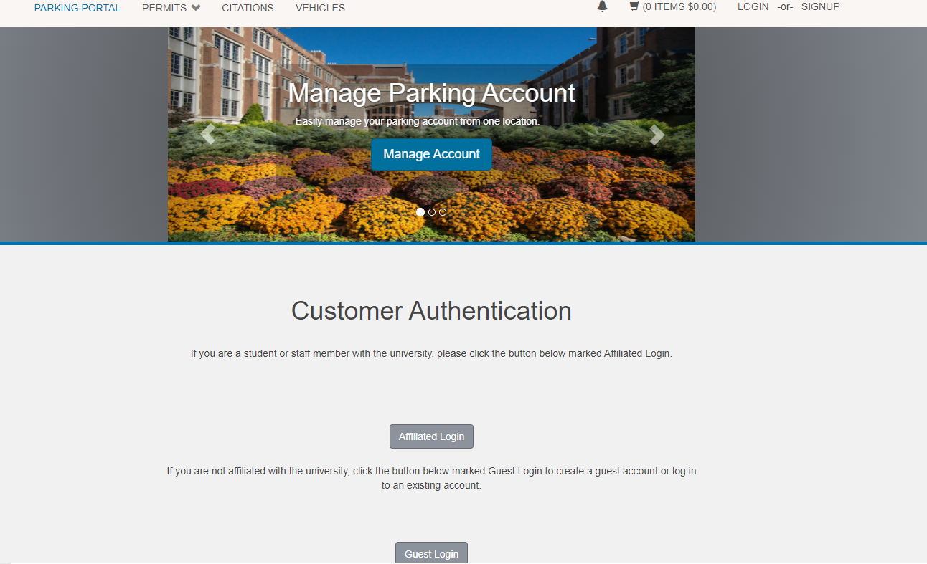
How to purchase a permit online
Sign into the Parking Portal
  Click on affiliated Login button
Click Here

Slide 3
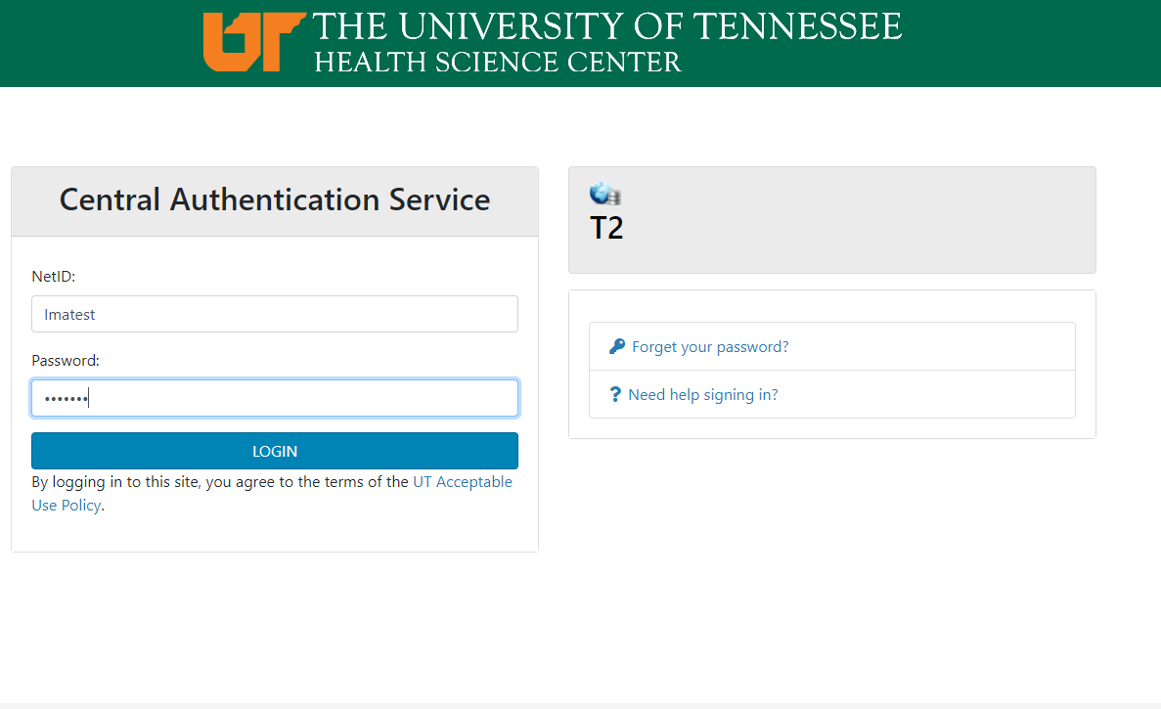
How to purchase a permit online
Enter your credentials and password into the Central Authentication Service
Click Here

Slide 4
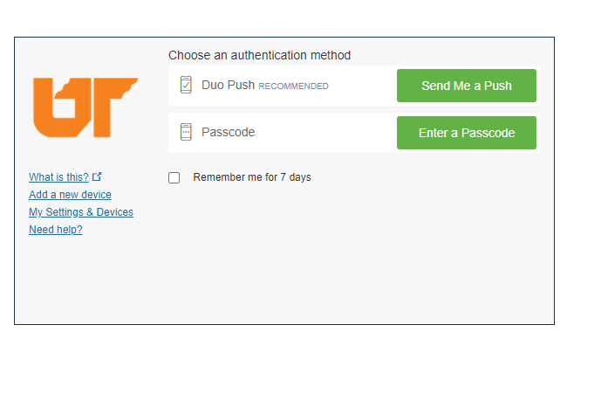
How to purchase a permit online
Choose and click on your choice for authentication
  Follow the authentication process and you will be entered into the parking portal
Click Here

Slide 5
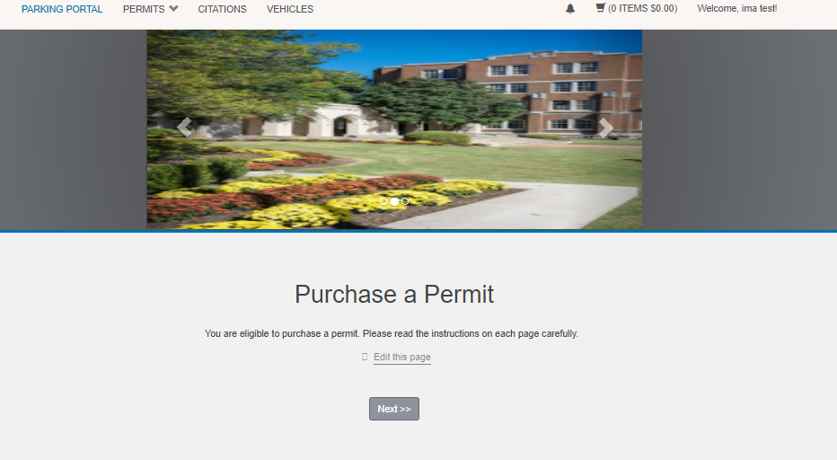
How to purchase a permit online
Click on the Next Button
Click Here
Click Here

Slide 6
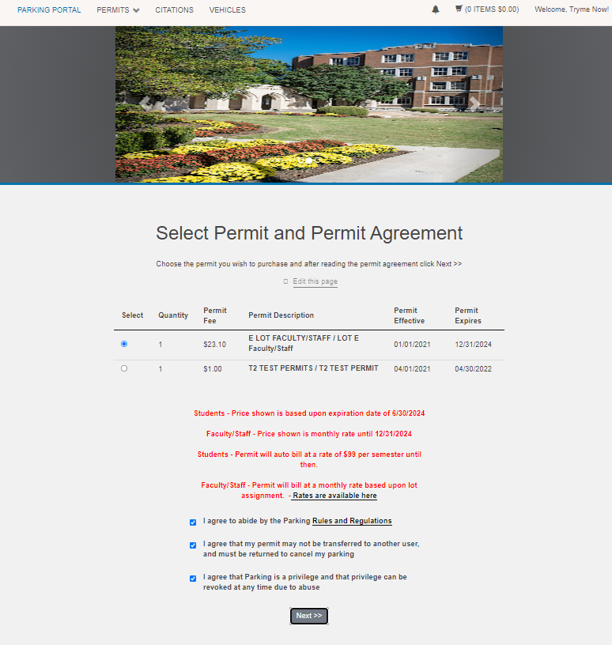
How to purchase a permit online
Select the permit you want
  The permits that are available are listed on the screen.
    If a permit isn’t listed that lot is full, you may sign up for the waiting list (shown in another video)
  Select your permit by clicking the select dot
  Click on the boxes to agree then click next
    You must agree to the 3 terms of use.

Slide 7
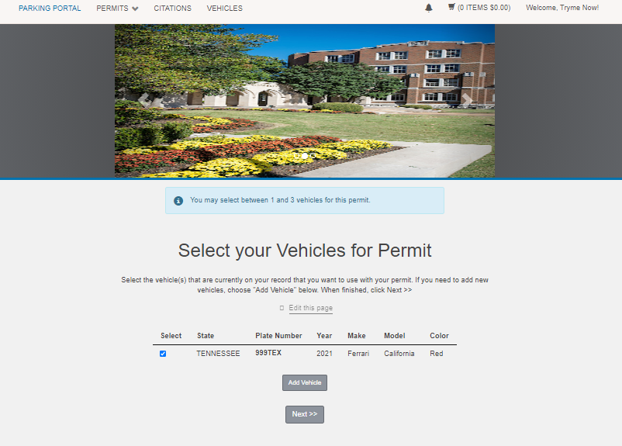
How to purchase a permit online
Select your vehicle, and or enter new vehicle information
  To select simply click on the select option
  To add a vehicle click on add vehicle
  If your vehicle is there and the info is correct click next
Click Here

Slide 8
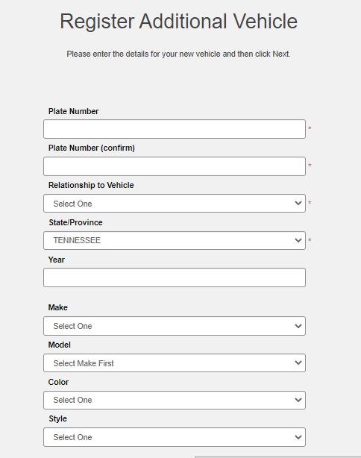
How to purchase a permit online
Adding a vehicle
  Enter your license plate number, no spaces and make sure you are correct
  Re enter your plate number
  Select your relationship to the vehicle
    Owner – which means the title is in your name
    Driver – You drive the vehicle but it is owned by another party
Click Here

Slide 9
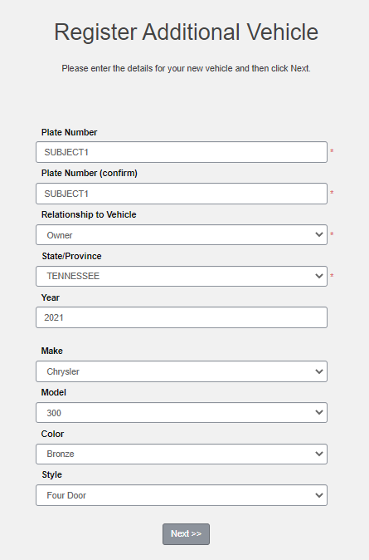
How to purchase a permit online
Adding a vehicle (2)
  Select the state the vehicle license plate is from
  Enter the year the vehicle was made (not required)
  Select the Make of the vehicle
    Example – Audi, Chevrolet, Ford
  Select the Model of the Vehicle
    Example – A5, Camaro, Mustang
Click Here

Slide 10
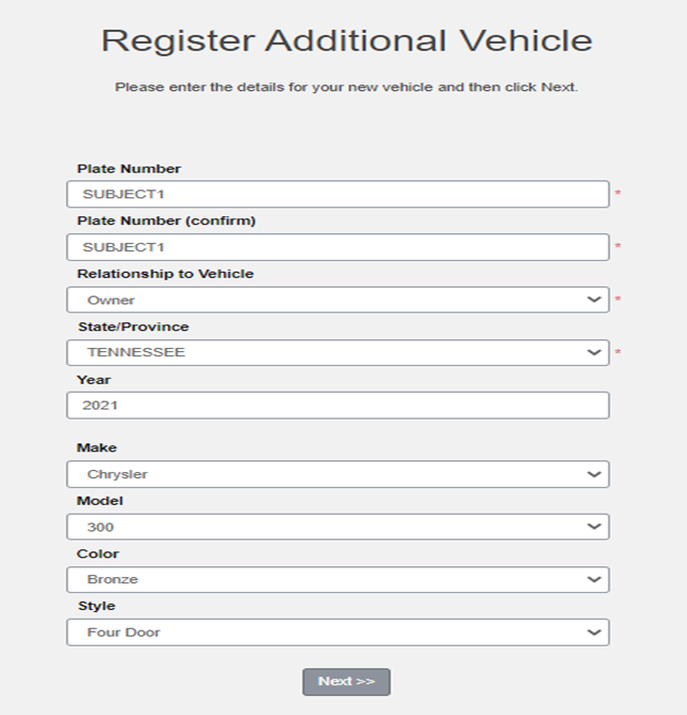
How to purchase a permit online
Adding a vehicle (3)
  Select Color of vehicle from dropdown
  Select style
    Example – Truck, 2 Door, 4 Door, SUV
  Click Next
Click Here

Slide 11
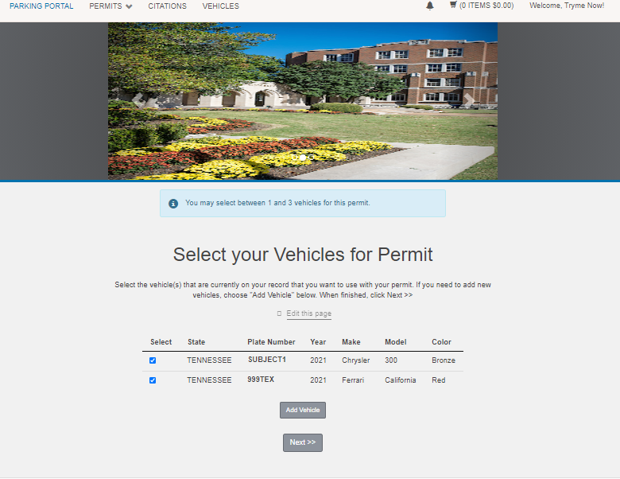
How to purchase a permit online
Once vehicle info is entered and you click next it is added to the list of vehicles you can select.
Click Next to continue
Click Here

Slide 12
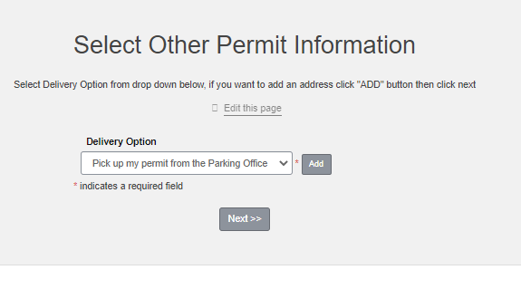
How to purchase a permit online
Select How you want to get the permit
  Mailed – to an address on your account
    You can add an address by clicking add behind the dropdown
  Pick up – at the parking office
Click Next after selecting
Click Here

Slide 13
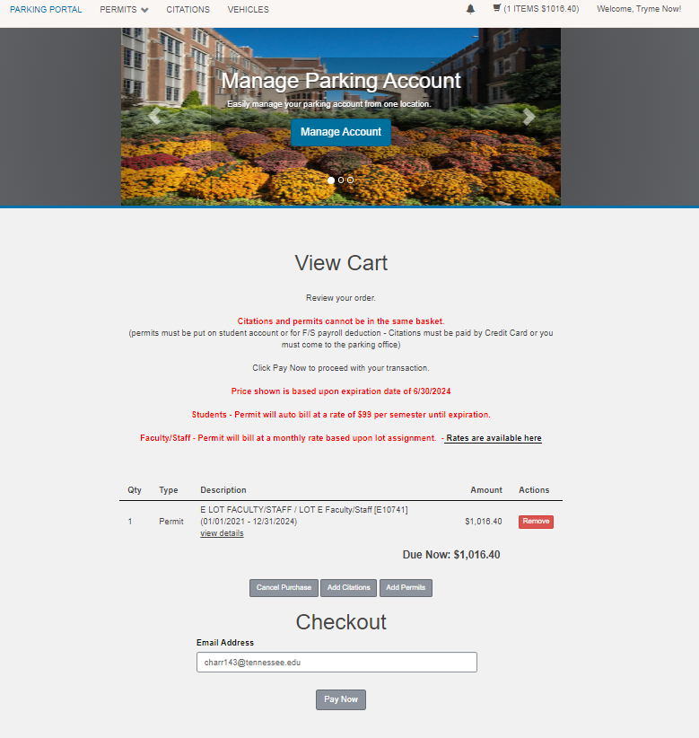
How to purchase a permit online
View your Cart
  Things to notice, your permit is valid until the date listed in the description (12/31/2024 in this example).
  Don’t worry about the Due Now number, It will be billed at the per month rate via payroll deduction until it expires. This big number is due to our permit lasting 4 years.
  Click Pay Now
Click Here
trymenow@uthsc.edu

Slide 14
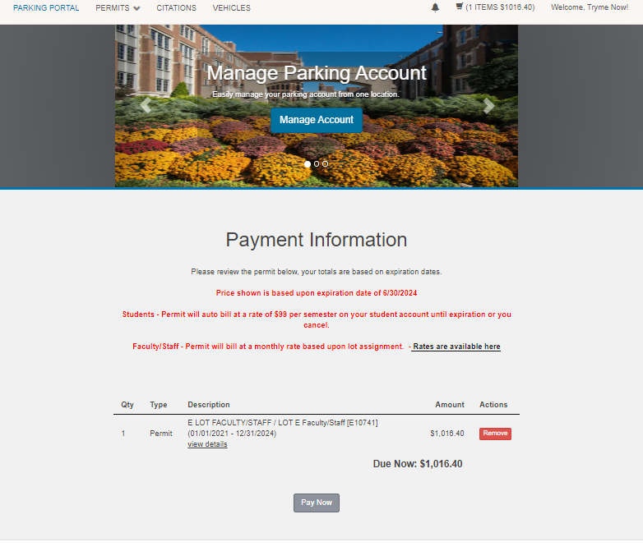
How to purchase a permit online
Same information, Click Pay Now to continue
Click Here

Slide 15
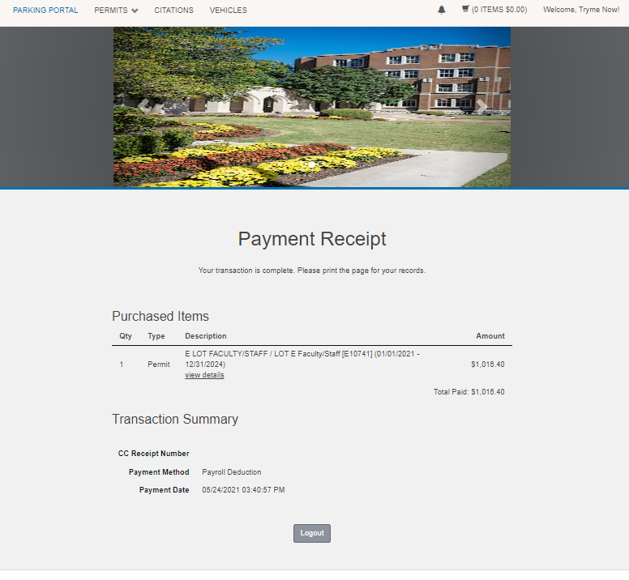
How to purchase a permit online
Your Purchase is complete
Here is your receipt
You can either log out or check your account from here.
  If you click on the permits drop down menu
Click Here

Slide 16
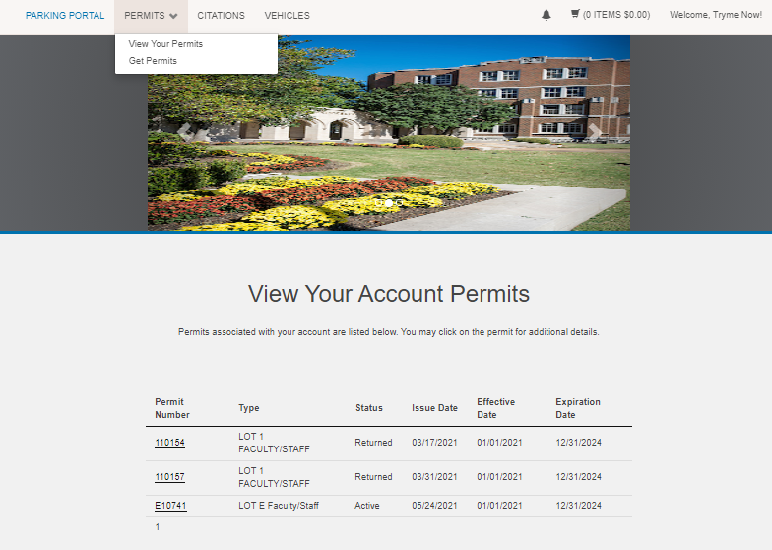
How to purchase a permit online
Click on permits
  Select view your permits
  Then it will show all active permits you have.
    Note: you will only be allowed to have one permit!
Click Here

Slide 17
Thanks for watching if you have questions please contact us:
UTHSC Parking Services
3 N. Dunlap Street
Memphis, TN 38163
Phone: 901.448.5549
Email: parkingservices@uthsc.edu

