Slide 1
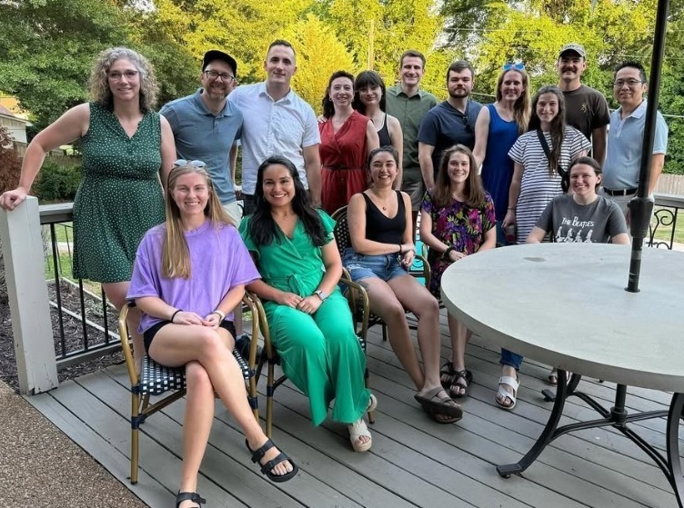

NEW STUDENT ORIENTATION
UTHSC College of Medicine – Chattanooga

Slide 2



Chattanooga Contacts
Karen Rogers, MD
Assistant Dean of Undergraduate Medical Education
615.210.9565
karenrogers14@gmail.com
Tiffany Nabors, BS, CMA (AAMA)
Medical Student Campus Coordinator
423.778.7442
tiffany.nabors@erlanger.org
Eli Kwak, BS, CMA
Medical Student Associate
423.778.4886
eli.kwak@erlanger.org

Slide 3


UT Medical Student Housing
The District at Riverside
Safety Reminder: DO NOT reside in an apartment not assigned to you or allow anyone else to stay in your assigned apartment other than the assigned roommate.
If you have any issues with your apartment, please reach out to Corporate Quarters and cc: Eli on the email.

Slide 4
What’s in my envelope?
ID Badge Reel
  Picture ID
  Proxy badge
  Meal card
  Exposure QR code
  UTHSC Medical Student badge buddy (PA students will need to use the PA badge they received in Memphis)
Information Sheet
  Login information
  Scrub pin code (You cannot swipe your badge for the scrub machine)
  Additional information regarding scrub machines & meal cards
Chattanooga

Slide 5
Appropriate Clothes & Attire
All departments require either professional dress or scrubs. This information was emailed to you in the Welcome email.
Scrubs: You are permitted to wear your school scrubs or Erlanger scrubs unless you are in a surgery suite. Erlanger scrubs must be worn for surgeries.
Each department will go over their specific dress code during orientation to the department. If you have any questions, please ask.

Slide 6
Scrubs for Students
Scrub machines for students are located on the 2nd floor in the surgery suite
Students cannot use scrub machines in the lounges
Students cannot scan their badge to get scrubs; you must use your scrub code
Take a picture of your scrub code and/or put it somewhere you will remember – you may need it for additional rotations here

Slide 7
Erlanger Computer & EPIC Access
You must have completed your Erlanger EOL EPIC (eChart) modules before you can log into an Erlanger computer.
To access Epic on your personal device, first you must log on to an Erlanger computer. Then you should be able to access EPIC via Canto or Haiku on your personal device.
Instructions for use on personal devices are included in the PowerPoint that will be emailed to you.

Slide 8


IMPORTANT Charting information
Please make sure you close all students notes in EPIC before your last day on rotation.
Do not check the box in EPIC that says, “Based on my professional judgment, sharing this note poses a risk of harm to this patient or another person.” This box can only be checked by a licensed clinician, and you’re not there yet. If your resident tells you to check it, please advise them you cannot since you are not a licensed clinician. Reach out with questions.

Slide 9

ATOS Erlanger IT Help Desk
423.778.TECH (8324)
*If you need a password reset:
please use sailpoint to reset your password.
We will walk through sailpoint
at the end of orientation.

Slide 10
You may not look up information on family, friends, co-workers, or others unless you are working with the patient or are on the patient’s case.
DO NOT take pictures of patients, charts, PHI, etc.
Violating HIPAA has penalties of fines and/or jail time
The UME department is made aware if you violate HIPAA, and you will be investigated.
HIPAA – need to know ONLY

Slide 11
Parking
Students are expected to park on the 2nd floor of the Erlanger parking garage on the Medical Mall side.
  Parking Ticket Validation
Currently there are no tickets for parking. If this changes, we will send out an announcement. Please keep an eye on your email.

Slide 12

  If you are leaving late at night, you can call 423.778.7614 to request Erlanger Security escort accompany you to your car.
  If there is no answer, call the Operator at 423.778.7000 and ask that the Security Supervisor be paged.
Erlanger Security Escort

Slide 13
Showers
Male and female showers are provided for medical students
Lockers and linens are available in those areas
Refer to your departments regarding their specific call spaces, lounges, storage for personal belongings during your clinical shifts.

Slide 14
Student Lounge, Workspace & Lockers
Lockers are available to store personal belongings. (You will need to supply your own padlock.)
A refrigerator, microwave, and Keurig coffee maker are available for student use.
A study/workspace area with 4 desktop computers and a printer is inside the lounge.

Slide 15

Medical Library
Students have 24/7 access to our UT Medical Library
  Location: 3rd Floor of the Whitehall Building
  Computers, printers and copiers are available
  All materials must be returned prior to check-out/departure
You have UpToDate access via UTCOM

Slide 16
Student Health Services
(UTHSC students only)
University of Tennessee at Chattanooga
University Health Services (UTC UHS)
University Health Services
is located in Maclellan Gym on UTC Campus:
615 McCallie Avenue
Chattanooga, TN 37403
Hours of Operation:
M-F 8:00 am – 5:00 pm EST
If you need medical attention please call 423.425.2266 to schedule an appointment. Identify yourself as a medical student. Bring your UT ID and insurance card to each visit.

Slide 17

Behavioral Health and Well-Being
Lucy White, MEd, LPC-MHSP, full-time counselor is available to all students at no charge
  Phone: 423.778.9420
  Email: lucy.white@erlanger.org
Stay tuned for wellness activities throughout the year

Slide 18
Inclement Weather Policy
In the event of severe weather or hazardous road conditions:
UTHSC College of Medicine–Chattanooga follows the delay or closing decisions made by University of Tennessee at Chattanooga (UTC).
If UTCOM–Chattanooga is closed, then clinical rotations and classes will be cancelled unless they can take place virtually.
Students should monitor communications regarding the availability of virtual educational activities.
You will be added to the UTCOM-Chattanooga Remind group for notification of campus closure. You may add yourself by texting @utcomchatt to 81010

Slide 19
Exposure to Blood or Bodily Fluids
All medical/PA students should follow these steps in the event of an exposure to blood or bodily fluids:
Notify your supervising resident and/or faculty member as soon as possible after exposure
Ask the Erlanger House Supervisor (or head nurse) in the area where the exposure occurred to help you complete an Erlanger Exposure Form for Non-Employees. Note: email Tiffany Nabors when you report the exposure; also complete the Exposure Form on OLSEN
The Nursing Supervisor or Erlanger Employee Health is authorized to order baseline tests (e.g., HIV and HBSAB) as well as the source patient at no charge to you or the patient.
Erlanger Employee Health will give recommendations for additional follow-up once all lab results are reviewed
If the exposure happens outside regular hours (M-F, 8 AM–4 PM), on weekends or holidays, contact Tiffany the next business day. If the patient is known to be positive, immediate treatment may be authorized. This decision would be made by the Nursing Supervisor or Erlanger Administrator on-call.
Erlanger ExpressCare downtown is located at: 325 Market Street, Suite 102, Chattanooga, TN 37402
423.778.4800 or 423.541.5122

Slide 20
Shelf Exams
Shelf exams are held at the end of the rotation in the Whitehall building computer classroom.
Noise-cancelling headphones are available in the testing room.
Please arrive at your designated time. Times will be sent to you.
If you have been approved for accommodations, please email your Clerkship Coordinator and Tiffany Nabors

Slide 21
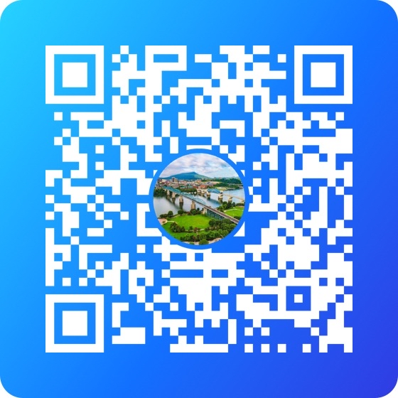
Chattanooga GroupMe

Slide 22
SailPoint
Go to: https://erlanger.identitynow.com
  You will need your current username & password
  (found on the info sheet in your envelope)
  Follow step-by-step directions
  Please let us know if you have trouble logging into SailPoint

Slide 23
Clerkship Contacts
Department | Clerkship/Course Director | Coordinator/Admin Staff
Emergency Medicine | Ken Maniscalco, MD kbmaniscalcojr@gmail.com | Hollie Daugherty 423.778.4696 hollie.daugherty@erlanger.org
Family Medicine | Sara Conway, MD sara.conway@erlanger.org | Charity Ross 423.778.2957 charity.ross@erlanger.org
Internal Medicine & Geri/Palli | Patrick Koo, MD patrick.koo@erlanger.org | Joyce Poke 423.778.6670 joyce.poke@erlanger.org
Neurology | Jake McKay, MD 423.778.9001 jake.mckay@erlanger.org | Stacey Blanks 423.778.3546 stacey.blanks@erlanger.org

Slide 24
Department | Clerkship/Course Director | Coordinator/Admin Staff
OB/Gyn | Jeanie Dassow, MD jeanie.dassow@erlanger.org | Connie Land 423.778.7515 connie.land@erlanger.org
Orthopaedics | Dirk Kiner, MD dirk.kiner@erlanger.org | Artnita Paris 423.778.9007 artnita.paris@eralnger.org
Pediatrics | Katy Hines, MD kathryn.hines@erlanger.org | Tammy Elliott 423.778.6696 tammy.elliot@erlanger.org
Plastic Surgery | Jason Rehm, MD Mark Brzezienski, MD, FACS | Allison Ellis allison.ellis@erlanger.org 423.763.4549

Slide 25
Department | Clerkship/Course Director | Coordinator/Admin Staff
Psychiatry | Audrey Hime, MD audrey.hime@tn.gov | Joyce Poke 423.778.6670 joyce.poke@erlanger.org
Radiology | Andrew Hill, MD andrew.hill@erlanger.org | Annette Vickrey 423.778.7371 annette.vickrey@erlanger.org
Surgery | J. Dan Stanley, MD FACS jdanstanley@gmail.com Stephen Greer, MD stephen.greer@erlanger.org | Kim Crawford 423.778.7695 kimberly.crawford@universitysurgical.com
Urology | Ethan Matz ethan.matz@erlanger.org | Kristin Burns 423.778.4691 kristin.burns@erlanger.org

Slide 26
Epic Access on Personal Devices
Haiku for iPhone or Android installation steps:
From your device, download the Haiku app from the Apple App store or Google Play
After the download is complete close the app
Once downloaded, click the link Haiku
Choose the link labeled “Click here to install Haiku production environment”
Haiku will open. Enter the password at the 1st prompt: 2lrWecf354
Login using your normal Epic username and password
Canto for iPad installation steps:
From your device, download the Canto app from the Apple App store or Google Play
After the download is complete close the app
Once downloaded, click the link Canto
Choose the link labeled “Click here to install Canto production environment”
Canto will open. Enter the password at the 1st prompt: 2lrWecf354
Login using your normal Epic username and password

Slide 27
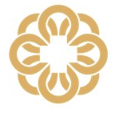
IMPORTANT REMINDER:
11 Rules for HIPAA Privacy & Information Security
DO NOT SHARE YOUR PASSWORD OR CREDENTIALS with anyone. If someone needs access, they must apply for their own.
DO NOT LEAVE YOUR WORKSTATION UNATTENDED while you are logged on. You are responsible for anything that occurs under your login, even if you know someone else did it.
DO NOT ACCESS PATIENT INFO using anyone else’s credentials.
DO NOT ACCESS ANY PATIENT INFO without a work-related reason. This includes yourself, your family, your friends, or people you hear about in the news. It also includes people for whom you are an emergency contact or have a POA; those do not permit you to use your work access to view their charts. Patient information includes all clinical information. It also includes the address, phone, email address, and everything else in Patient Lookup.
DO NOT RELEASE PAPERWORK, AVS, LAB RESULTS, or anything else to a patient before verifying the patient’s correct name.
DO NOT PRINT ANYTHING other than the current After Visit Summary (AVS) without a proper Release of Information (ROI) on file. If a patient needs a copy of their records, refer them to MyChart. When in doubt, contact Erlanger’s ROI Customer Service at 423.778.4185.
DO NOT POST ANY PATIENT INFO on any social media platform, even if you think it doesn’t identify the patient. Dates of treatment, diagnoses, and unique details are all patient identifiers, even without a name or photo included.
DO NOT TAKE PHOTOS OF PATIENTS, PHI, or EHS proprietary info for any purpose other than as an addition to the chart.
DO NOT SEND PHI TO YOUR PERSONAL EMAIL or store it on your personal device.
DO NOT STORE ANY PHI/PII or any other confidential information related to the organization in any cloud storage unless approved by the IT Information Security and Privacy offices. If you have not been granted access and permissions, you should store it on your assigned shared drive.
DO NOT SEND ANY EMAIL CONTAINING PHI or confidential employee information (in the body or the attachment) to an address outside of EHS, even if it’s being sent to one of our partner organizations, without including “CONFIDENTIAL” in the subject line.
QUESTIONS? WE’RE HERE TO HELP.
Call Privacy & Compliance at 423.778.7703
or email: privacy@erlanger.org

Slide 28
Meal Cards
Student meal cards are loaded with $15 every week and can be used at:
Erlanger Baroness Bistro cafeteria (including Chick-fil-A, Subway, hot stations, salad bar, and convenience items)
Starbucks (in the Medical Mall)
Note:
Meal card balances do not roll over!
Reloads are scheduled to occur every Monday around 10AM but can vary based on Sodexo staff schedules or holidays
Questions?
Email Eli (eli.kwak@erlanger.org)

Slide 29
This will need to be done from any Erlanger workstation:
Click the UpToDate link on the Medical Library’s intranet page (found under the Education tab on the Erlanger intranet home page)
Look in the upper right corner of the UpToDate page for the link to create your account
Set up your own account using any username and password
Use your new account info to log into the app from your phone or device
This account will need to be accessed once a month from an Erlanger workstation within campus in order to stay active
If you have any questions, contact Rachel Bohannon at rachel.bohannon@erlanger.org or 423.778.7498
UpToDate via UTCOM/Erlanger

Slide 30
Links to Important Policies
UTHSC College of Medicine policies:
  Work Hours Policy
  Grading for the MD Curriculum Policy
  Student Mistreatment Policy
  Professionalism Policy
  Student Substance Abuse Policy
Erlanger Health System policies:
  Professional Dress Code Policy
  Social Media Policy
  Solicitation and Literature Distribution Policy
  Return to Work Policy
These and other policies can be found on the COLSEN, OLSEN or MERL websites.

Slide 31
Excused Absences, Wellness Days, and
Limited Leave Request Forms
Please review the Excused Absence and Wellness Day Policy
Please submit the Limited Leave Request Form to your Clerkship Director for approval

Slide 32
Student Assistance Program
The ENI NexGen Student Assistance Program (SAP) is available for UTHSC students.
SAP is a confidential program that motivates students experiencing difficult personal situations to seek or accept professional assistance thus preventing personal concerns from undermining their well-being and academic performance. SAP offers brief, short term, professional counseling for academic troubles, marital and family concerns, substance and alcohol abuse, stress, anxiety, and depression. It also identifies referrals for assistance with other problems encountered in daily living.
The services of the SAP are confidential and are delivered by a professional organization by the name of ENI NexGen Total Well-Being Program.
Eni provides personal consultation 24/7 for situations that can affect your well-being or academic performance.
As a registered UTHSC student, you pay a small assessment for SAP services each semester. You will incur no additional out of pocket expenses and are entitled to be referred for up to 6 counseling sessions per year. Spouses and partners may also be included in the counseling sessions. Although you may opt for phone counseling, you will find that you have a convenient choice of ENI’s network of counselors located on or near campus or in the U.S.
Call: 1.800.327.2255 or visit: https://www.uthsc.edu/health-services/behavioral-health/sap.php

Slide 33
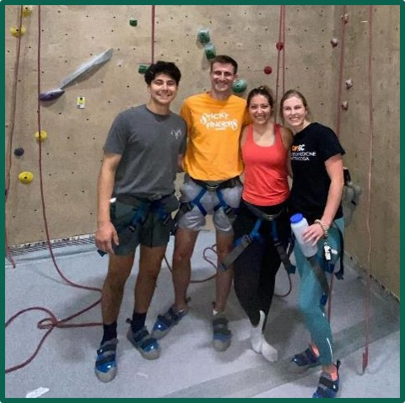
THANK YOU!
We hope you enjoy your time in Chattanooga and at Erlanger!

