Slide 1
New ORA Contract Staff, Subaward Information and Tools
3/18/15

Slide 2
New ORA Staff
Elaine Todd, J.D., Associate Director
901 448-3303
etodd5@uthsc.edu

Slide 3
Subaward Training Session
To be announced – what is a good time?
New Policy
New Forms
Sub commitment form (replaces old letter of intent)
FDP forms and amendments
Instructions for using new forms
New Tools
Determining vendor/consultant/subrecipient
Sub risk assessment
Required elements for subs
Optional requirements for high-risk subs

Slide 4
New Policy
FI0230 – Sponsored Projects - Subaward Origination and Subrecipient Monitoring http://policy.tennessee.edu/fiscal_policy/fi0230/

Slide 5
New Tool
Determination Guide for Agreements with External Entities/Individuals http://13134m1l2szd36ie6w8tg1djw2.wpengine.netdna-cdn.com/wp-content/uploads/2015/01/Exhibit-01-UG-detrmination-chart-for-sub-vs-vendor-10-27-2014.docx - criteria for distinguishing among consultants, subrecipients, and vendors

Slide 6
New Tool
Uniform Guidance - Required Subrecipient Risk Assessment by Pass-Through Entities http://13134m1l2szd36ie6w8tg1djw2.wpengine.netdna-cdn.com/wp-content/uploads/2015/01/Exhibit-02-Uniform-Guidance-%E2%80%93-Required-Subrecipient-Risk-Assessment-by-Pass-Through-Entities.docx – identifying high-risk subs so that we can include additional reporting requirements – include note in PAMS about risk assessment

Slide 7
New Tool
Required Elements for Subs http://13134m1l2szd36ie6w8tg1djw2.wpengine.netdna-cdn.com/wp-content/uploads/2015/02/Exhibit-03-Uniform-Guidance-%E2%80%93-Required-Elements-for-Subawards.docx – List of all information now required to be included in subawards

Slide 8
New Tool
Optional Requirements for High-Risk Subs http://13134m1l2szd36ie6w8tg1djw2.wpengine.netdna-cdn.com/wp-content/uploads/2015/02/Exhibit-04-UT-Optional-Requirements-for-High-Risk-Subs-rev-11-20-14.docx

Slide 9
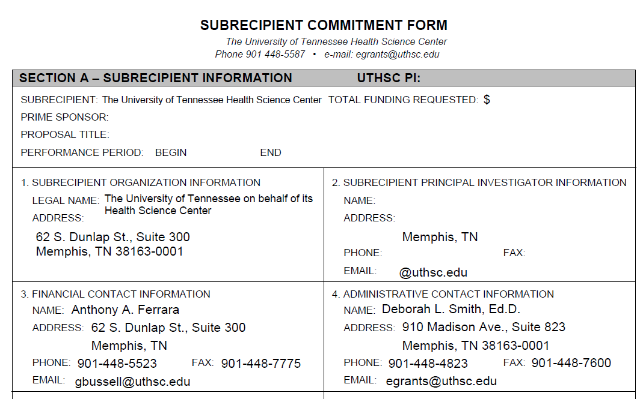
New Subrecipient Commitment Forms
New form takes the place of the old “letter of intent” – UT version is pre-filled

Slide 10
New Subaward Forms
Will be posted to the ORA web site: http://www.uthsc.edu/research/research_administration, along with instructions for how to use them

