Slide 1

University of Tennessee Health Science Center
Department of Occupational Therapy
Curriculum Design

Slide 2
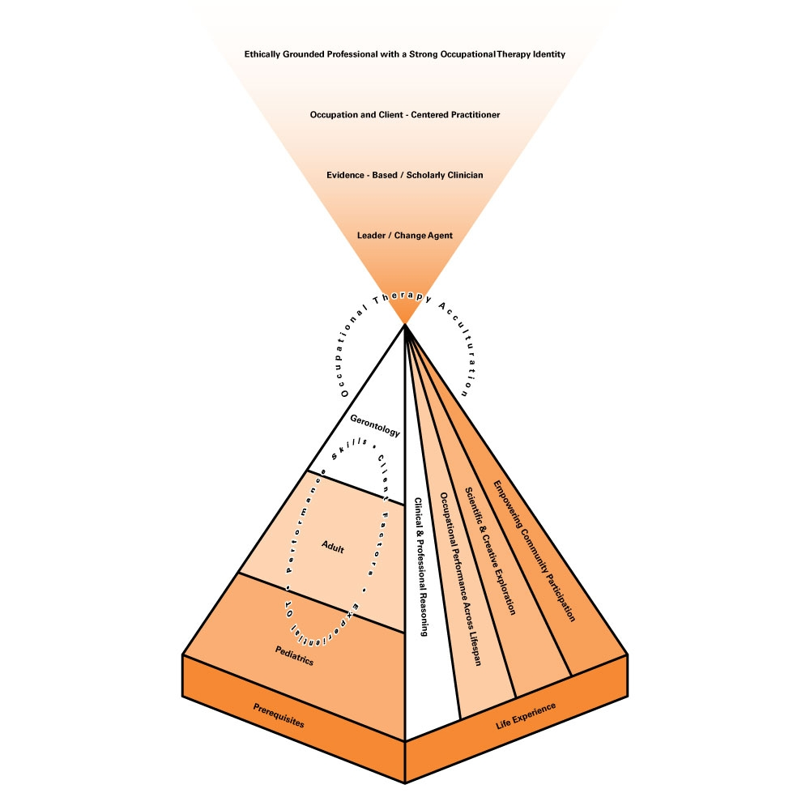
The University of Tennessee Health Science Center
Occupational Therapy Department
Curriculum Design

Slide 3
Components Pyramid
Foundation
Life Span
+ Occupational Therapy Skills
________________________
OT Acculturation

Slide 4
Foundation
We recognize and require all students to come to the program with defined
Pre- Requisite Coursework
And Unique
Life Experiences

Slide 5
Pre-Requisites
General Biology (Including Zoology)
Anatomy & Physiology
General Chemistry
Kinesiology
English Composition
Speech
Psychology:
General
Lifespan
Abnormal
Social Science:
General Sociology
Anthropology
Recommended Humanities
Foreign language
Philosophy, logic, or ethics
Statistics
Medical Terminology
Recommended Electives
Computer/technology Education
Technical or critical writing Fine and performing arts (e.g., woodworking, ceramics, photography)

Slide 6
Life Span
The curriculum is designed to cover the lifespan:
Pediatrics
Adult
Geriatrics

Slide 7
Components
Within each area of the life span, students learn:
Performance Skills
Client Factors
Experiential Occupational Therapy

Slide 8
Performance Skills
Motor and praxis
Sensory-perceptual
Emotional regulation
Cognitive
Communication and social skills

Slide 9
Client Factors
Body Functions
Body Structures
Values
Beliefs
Spirituality

Slide 10
Experiential Occupational Therapy
Active, hands-on learning
Team-based learning
Simulation with standardized patients
Community service experiences
Labs
Fieldwork
Competency assessments in core clinical skills

Slide 11
Occupational Therapy Skills
Throughout the curriculum advancement in student performance is made in the following areas:
Clinical and Professional Reasoning
Occupational Performance Across the Lifespan
Scientific and Creative Exploration
Empowering Community Participation

Slide 12
Clinical and Professional Reasoning
Cognitive processes (e.g., ethical, narrative, scientific, and pragmatic reasoning) used to guide professional actions and interactions including:
  Planning
  Directing
  Performing
  Reflecting on client care
  Schell & Schell, 2008

Slide 13
Occupational Performance
Across the Lifespan
“The act of doing and accomplishing a selected activity or occupation that results from the dynamic transaction among the client, the context, and the activity” (American Occupational Therapy Association, 2008, pp. 672-673) and how this occurs along the continuum from birth to death.

Slide 14
Scientific and Creative Exploration
Supporting and promoting development of curiosity, inquisitiveness, and excited engagement in the problem-solving process, leading to innovative and creative approaches, projects, research, and critical discourse in the art and science of occupational therapy.

Slide 15
Empowering Community Participation
Supporting and promoting engagement in evidence-based and occupation-centered practice in the client’s natural environment in order to facilitate development of the ability to empower clients to advocate for themselves toward improved health and participation (Dunbar, 2009).

Slide 16
Occupational Therapy Acculturation
The end result of our program provides a student with the knowledge, skills, and an OCCUPATIONAL THERAPY ACCULTURATION

Slide 17
Educational Outcomes
Occupation and Client Centered Practitioner
Evidence based and Scholarly Clinician
Ethically Grounded Professional with a Strong Occupational Therapy Identity
Leader Change Agent

Slide 18

OUTCOMES MEASUREMENT

Slide 19
CLINICAL
Outcome Measurements
Experiential Learning and Practical Assessments
Advisors and Professional Development Evaluation
AOTA Fieldwork Performance Evaluation for Level I and II Fieldwork
Blackboard Discussions and Reflection
Student Evaluation of Fieldwork Experience

Slide 20
Experiential Learning
Labs and Simulations
Community Initiatives
Level I Fieldwork
Level II Fieldwork

Slide 21
Mentors and Professional Development Evaluation (PDE)
Throughout the occupational therapy program, students meet with an academic mentor and present evidence of proficiency in behavioral criteria related to the following professional development areas:
Occupation and Client-Centered Practice
Ethically Grounded with a Strong OT Identity
Evidence-Based/Scholarly Clinician
Leader Change Agent

Slide 22
PDE: Occupation and Client-Centered Practice Criteria
Openly an actively listens utilizing non-verbal communication; demonstrates a caring, empathetic and non judgmental manner
Remains open to differences and recognizes own biases; appreciates the uniqueness of individuals
Focuses on the client’s beliefs, values and goals
Appreciates the role of occupation, and the importance of balancing pleasurable, productive and restful occupations to promote health and well-being
Recognizes the influence of social conditions and the context in which people choose to engage
Uses the term occupation in all documentation to articulate the role of occupational therapy

Slide 23
PDE: Ethically Grounded with a Strong OT Identity Criteria
Respects faculty and classmates by arriving punctually for class, meetings and fieldwork assignments; to include communicating when circumstances prevent attendance or in making up missed assignments
Displays altruism in day to day situations
Takes pride in the profession of occupational therapy by articulating the benefit of OT to potential consumers
Integrates the AOTA Code of Ethics in day to day situations
Demonstrates integrity in problem solving situations

Slide 24
PDE: Evidence-Based/Scholarly Clinician
Demonstrates a positive attitude toward learning by focusing on lecture and presentations; offering questions for clarification and comments that facilitate class discussion
Uses APA or appropriate guidelines in all scholarly work, utilizing a comprehensive list of publications and other sources
Demonstrates a working knowledge of scholarly writing terminology, such as:
  Identifies difference between reference and Bibliography
  Defines the difference between quantitative and qualitative research
Gathers information from multiple sources, such as:
  search engines, texts, observations, professional journals
  International OT and relate health care journals
Uses critical thinking and evaluation in scholarly writing, to include the following:
  Discerns relevant from irrelevant information
  Uses critical thinking and problem solving when drawing conclusions
  Accepts that there may be more than one answer to a problem

Slide 25
PDE: Leader Change Agent Criteria
1. Effectively uses both verbal and written communication in all learning settings; to include:
  Seeks out and provides constructive feedback to enhance learning environment
  Exhibits professional demeanor as evidences by posture, body language, tone of voice and general appearance
  Maintains 2-way communication with instructors
  Utilizes appropriate lines of authority for conflict resolution
2. Takes responsibility for learning, to include timeliness, preparation for, and participation in all OT learning
3. Demonstrates a “can do” attitude by being proactive and solution oriented, to include being:
  flexible in unexpected situations
  a self-starter
  positive in the face of adversity or when facing a challenge
4. Takes responsibility for professional and personal growth by
  Self monitoring behavior to become aware of personal and professional strengths and limitations
  Assuming responsibility for ones own actions and behaviors
  Practicing a balanced and healthy lifestyle
5. Enhances effectiveness of the team (small group) by:
  Promoting a positive, caring environment while building trust
  Motivating others to work towards a common goal
  Showing respect to others by openly accepting different ideas

Slide 26
AOTA Level I Fieldwork Evaluation
Provides a quantitative tool to measure student success in the categories of:
Professionalism
Communication
Clinical Skills

Slide 27
AOTA Fieldwork Performance Evaluation (FWPE)
Fundamentals of Practice
Basic Tenets of Occupational Therapy
Evaluation and Screening
Intervention
Management of Occupational Therapy Services
Communication
Professional Behavior

Slide 28
Student Evaluation of
Fieldwork Experience
The Student Evaluation of Fieldwork Experience is a useful tool in the curriculum as it:
Provides an opportunity for the student to provide feedback to the fieldwork educator and site
Create an opportunity for the academic program, fieldwork site, and fieldwork educator to refine their fieldwork program
Ensure the fieldwork reflects the sequence, depth, focus and scope of the curriculum
Identify current evaluations, treatments, theories, and student assignments used in practice which are used the refinement of didactic courses
Identifies strengths and weaknesses in the curriculum as they relates to current practice

Slide 29
Level II Blackboard Discussions
An online blackboard discussion is utilized to further gather information regarding the student’s:
clinical and professional reasoning
facilitation of occupational performance across the lifespan
utilization of scientific and creative exploration
engagement in empowering community participation

Slide 30
Blackboard Discussion Questions
Each student shares a response and identifies:
a situation that they used occupation-based practice on fieldwork
a situation that they used client-based practice on fieldwork
strategies they used to promote occupation-based, client-centered, evidence based practice
how occupational therapy is addressing psychosocial issues on the fieldwork
opportunities they had to work collaboratively with clients, families, colleagues in a professional context respective diverse social/cultural values and practice
a situation they took on a leadership role during fieldwork
a situation which had an ethical dilemma and how it was processed and resolved
opportunities they have had to promote the profession of occupational therapy’s unique values, beliefs, and roles
how their short term professional goals were effected based on the fieldwork experience

Slide 31
Accumulation of Knowledge
The information gathered on fieldwork from students and fieldwork educators is presented to the faculty. This process allows the occupational therapy program to adapt and change to the current trends in the profession.

