Slide 1
Promotion & Tenure
2025

Slide 2
Agenda
Letters of Reference
  Minimum Number
  Solicitation
  Letter Database for Each Faculty
  Judging Acceptability of Letters
Early Promotion and Tenure
Peer Review of Teaching
Required Forms
  Form 5 – Promotion Checklist
  Promotion Metric
  Department Committee Report
Joint Appointments
Additional Reference Material
Common Issues Noted by CAPT Committee
Chair letter “If-Thens”
ALL forms and instructions are on the College of Medicine Faculty Affairs Website
https://www.uthsc.edu/medicine/facultyaffairs/index.php

Slide 3
Minimum Letters Needed
Type of Action | Min# of ¹Internal Letters | Min # of ²External Letters
A. Instructor to Assistant Professor | 3 | 0
B. Assist to Assoc WITHOUT tenure | 3 | 2
C. Assist to Assoc WITH tenure | 2 | 3
D. Assoc to Professor any tenure status | 2 | 3
E. Tenure without Promotion (“a” below) | 2 | 3
Internal versus External
¹Internal: UTHSC or UTHSC affiliates like St Jude or VA
²External: not employed or affiliated with UTHSC
In the case of tenure review only, letter writer must be (a) at or above the candidate’s current rank, or
(b) at or above the rank to which the candidate aspires to be promoted to.
For consideration for the award of tenure for a UTHSC faculty, the letter writer MUST be tenured and state as much in the letter of reference.

Slide 4
Soliciting Letters
Must use email template provided
Send as text in body of email
Fill out information in red font and change it to black font
Add TWO attachments: CV and UTHSC Promotion and Tenure Criteria
Date should be BEFORE meeting of department committee
Letter should be sent as an attachment to the email you have received this communication from (we do not need an original copy of the letter)
Note the requirements they must do – this will become important in a minute
Note enclosures
Note this email should be cc’ed to the chair of dept

Slide 5
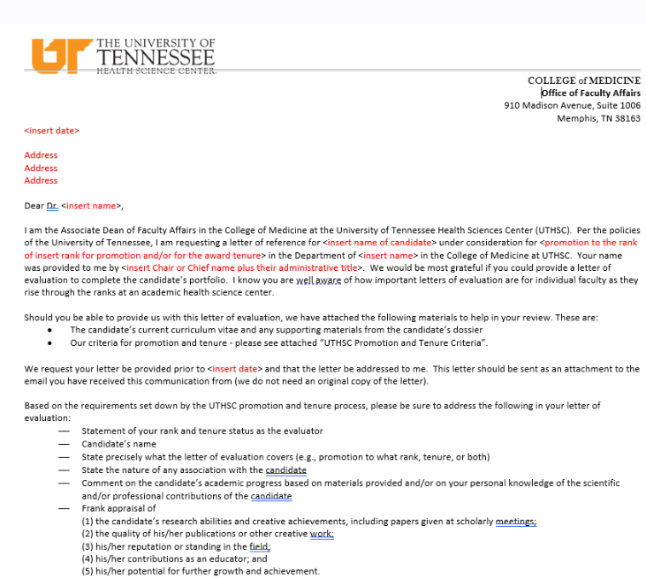
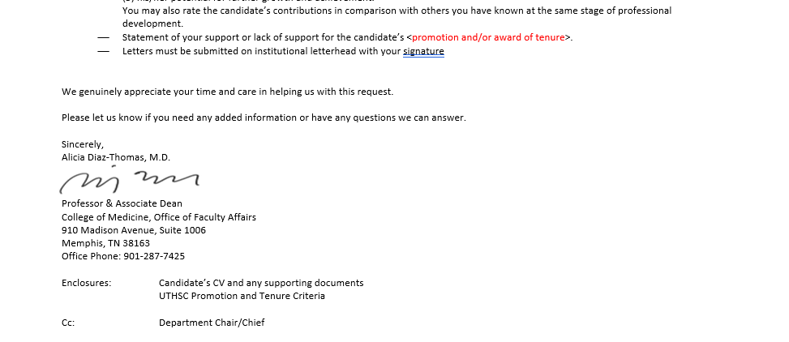
QUESTIONS?

Slide 6
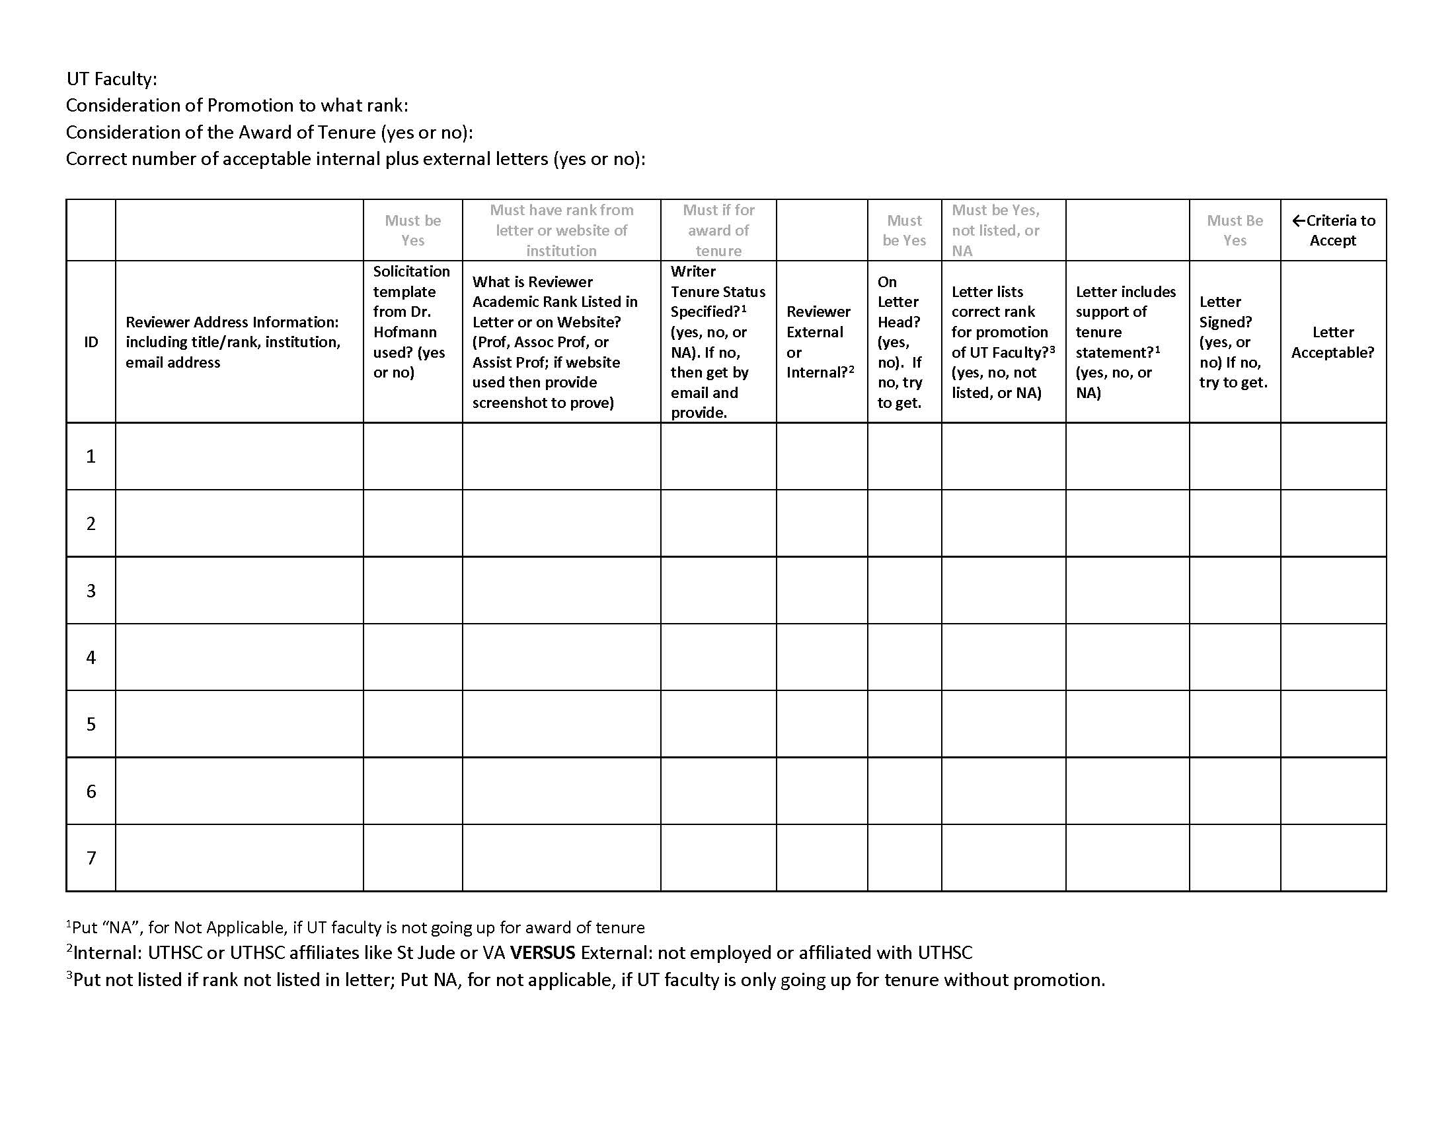
Required Letter-Database
For Each Faculty

Slide 7
Example
Letter Database for Dr Bob Smith
UT Faculty: Bob Smith
Consideration of Promotion to what rank: Associate Professor
Consideration of the Award of Tenure (yes or no): Yes
Correct number of acceptable internal plus external letters (yes or no):
Patricia Smith, PhD
Professor, Dept Physiology
University of Texas at Austin
Psmith@texas.edu
yes
?
?
?
?
?
?
?
¹Put “NA”, for Not Applicable, if UT faculty is not going up for award of tenure
²Internal: UTHSC or UTHSC affiliates like St Jude or VA VERSUS External: not employed or affiliated with UTHSC
³Put not listed if rank not listed in letter; Put NA, for not applicable, if UT faculty is only going up for tenure without promotion.

Slide 8
Rank???

Slide 9
Example
Letter Database for Dr Bob Smith
UT Faculty: Bob Smith
Consideration of Promotion to what rank: Associate Professor
Consideration of the Award of Tenure (yes or no): Yes
Correct number of acceptable internal plus external letters (yes or no):
Patricia Smith, PhD
Professor, Dept Physiology
University of Texas at Austin
Psmith@texas.edu
yes
Prof
?
?
?
?
?
?
¹Put “NA”, for Not Applicable, if UT faculty is not going up for award of tenure
²Internal: UTHSC or UTHSC affiliates like St Jude or VA VERSUS External: not employed or affiliated with UTHSC
³Put not listed if rank not listed in letter; Put NA, for not applicable, if UT faculty is only going up for tenure without promotion.

Slide 10
Tenure Status???

Slide 11
What to do if you need tenure status of evaluator?
Follow up email
Dear Dr. Smith,
Thank you for providing a letter of evaluation for Dr. Bob Smith.
To finalize this letter for use in the dossier for Dr. Smith’s promotion and tenure,
can you please share with me your own tenure status. Our Board of Trustees
requires that we obtain such information related to our evaluators.
Again, thank you for your help
Judy Farmer
P&T Coordinator Department of Pediatrics
Response
Judy, I am tenured. Pat

Slide 12
Example
Letter Database for Dr Bob Smith
UT Faculty: Bob Smith
Consideration of Promotion to what rank: Associate Professor
Consideration of the Award of Tenure (yes or no): Yes
Correct number of acceptable internal plus external letters (yes or no):
Patricia Smith, PhD
Professor, Dept Physiology
University of Texas at Austin
Psmith@texas.edu
yes in attached email
yes
Prof
external
yes
?
?
?
?
¹Put “NA”, for Not Applicable, if UT faculty is not going up for award of tenure
²Internal: UTHSC or UTHSC affiliates like St Jude or VA VERSUS External: not employed or affiliated with UTHSC
³Put not listed if rank not listed in letter; Put NA, for not applicable, if UT faculty is only going up for tenure without promotion.

Slide 13
Lists correct Rank for Bob Smith???

Slide 14
Example
Letter Database for Dr Bob Smith
UT Faculty: Bob Smith
Consideration of Promotion to what rank: Associate Professor
Consideration of the Award of Tenure (yes or no): Yes
Correct number of acceptable internal plus external letters (yes or no):
Patricia Smith, PhD
Professor, Dept Physiology
University of Texas at Austin
Psmith@texas.edu
yes in attached email
yes
Prof
external
yes
Not listed
?
?
?
¹Put “NA”, for Not Applicable, if UT faculty is not going up for award of tenure
²Internal: UTHSC or UTHSC affiliates like St Jude or VA VERSUS External: not employed or affiliated with UTHSC
³Put not listed if rank not listed in letter; Put NA, for not applicable, if UT faculty is only going up for tenure without promotion.

Slide 15
Support of tenure statement?

Slide 16
Example
Letter Database for Dr Bob Smith
UT Faculty: Bob Smith
Consideration of Promotion to what rank: Associate Professor
Consideration of the Award of Tenure (yes or no): Yes
Correct number of acceptable internal plus external letters (yes or no):
Patricia Smith, PhD
Professor, Dept Physiology
University of Texas at Austin
Psmith@texas.edu
yes in attached email
yes
Prof
external
yes
Not listed
yes
yes
yes
¹Put “NA”, for Not Applicable, if UT faculty is not going up for award of tenure
²Internal: UTHSC or UTHSC affiliates like St Jude or VA VERSUS External: not employed or affiliated with UTHSC
³Put not listed if rank not listed in letter; Put NA, for not applicable, if UT faculty is only going up for tenure without promotion.

Slide 17
Minimum Letters Needed
Type of Action | Min# of ¹Internal Letters | Min # of ²External Letters
A. Instructor to Assistant Professor | 3 | 0
B. Assist to Assoc WITHOUT tenure | 3 | 2
C. Assist to Assoc WITH tenure | 2 | 3
D. Assoc to Professor any tenure status | 2 | 3
E. Tenure without Promotion (“a” below) | 2 | 3
Internal versus External
¹Internal: UTHSC or UTHSC affiliates like St Jude or VA
²External: not employed or affiliated with UTHSC. Former UT Faculty are external
In the case of tenure review only, letter writer must be (a) at or above the candidate’s current rank, or
(b) at or above the rank to which the candidate aspires to be promoted to.
For consideration for the award of tenure for a UTHSC faculty, the letter writer MUST be tenured and state as much in the letter of reference.

Slide 18
Example
Letter Database for Dr Bob Smith
UT Faculty: Bob Smith
Consideration of Promotion to what rank: Associate Professor
Consideration of the Award of Tenure (yes or no): Yes
Correct number of acceptable internal plus external letters (yes or no): 2 internal = yes; 3 external = yes
Patricia Smith, PhD
Professor, Dept Physiology
University of Texas at Austin
Psmith@texas.edu
yes in attached email
yes
Prof
external
yes
Not listed
yes
yes
yes
¹Put “NA”, for Not Applicable, if UT faculty is not going up for award of tenure
²Internal: UTHSC or UTHSC affiliates like St Jude or VA VERSUS External: not employed or affiliated with UTHSC
³Put not listed if rank not listed in letter; Put NA, for not applicable, if UT faculty is only going up for tenure without promotion.

Slide 19
QUESTIONS?

Slide 20
Early Promotion
When is a promotion considered “early” (for 2024 - 2025 P&T cycle)?
  For faculty to be promoted to Associate Professor, they must have been an Assistant Professor (at any reputable institution) for a total of 4 years (48 months). Thus, if they were initially named an Assistant Professor August 1, 2021, then they are requesting an EARLY promotion (47 months).
  For faulty to be promoted to Professor, they must have been an Associate Professor (at any reputable institution) for a total of 5 years (60 months). Thus, if they were initially named an Associate Professor August 1, 2020, then they are requesting an EARLY promotion (59 months).
  There may be some exceptions to these rules if a faculty took time off from being on faculty, i.e. entered private practice. Consult with this office if there is such a break in their academic record. Prior years at another Institution count toward meeting criteria in rank. This information must be included in the Chair letter and Department Report.

Slide 21
Early Tenure
When is the award of tenure considered “early” (for 2024 - 2025 P&T cycle)?
  All tenure-track periods are now set at 6 years per our Board of Trustees. The 6 years is only counted for time spent at UTHSC.
  Thus, if a tenure-track faculty was initially name on to the tenure-track after July 1, 2019 at UTHSC, then they are requesting an EARLY tenure review.
  There will be exceptions to this rule if the faculty received an extension or suspension of their tenure clock. Consult with our office in these cases.
  If tenure probation extension is granted to 2026, but the faculty decides to come up in 2025, it is not considered early.

Slide 22
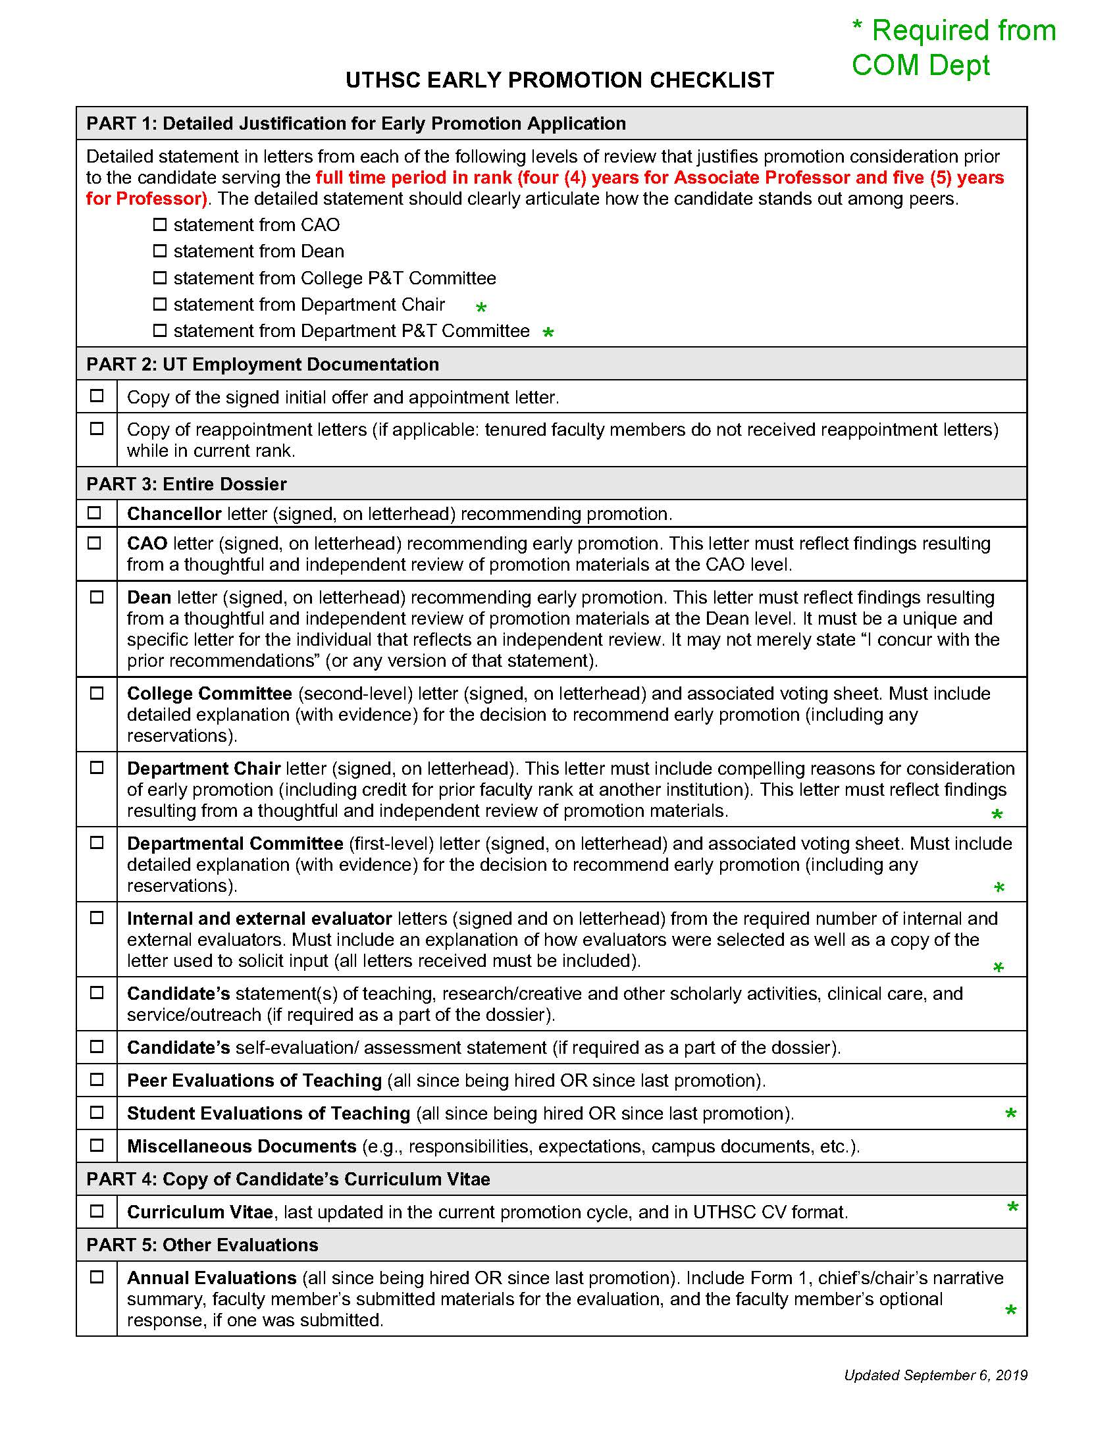
Extra Documents Required
For Early Promotion at Department Level
Annual Reviews since being hired or last promotion
Documentation on Student Evaluation of Teaching
Department P&T Letter must have explanation/evidence for basis of decision for early promotion – “Why are they are rock star?”
Chair Letter must have explanation/evidence for basis of decision for early promotion – “Why are they a rock star?”

Slide 23
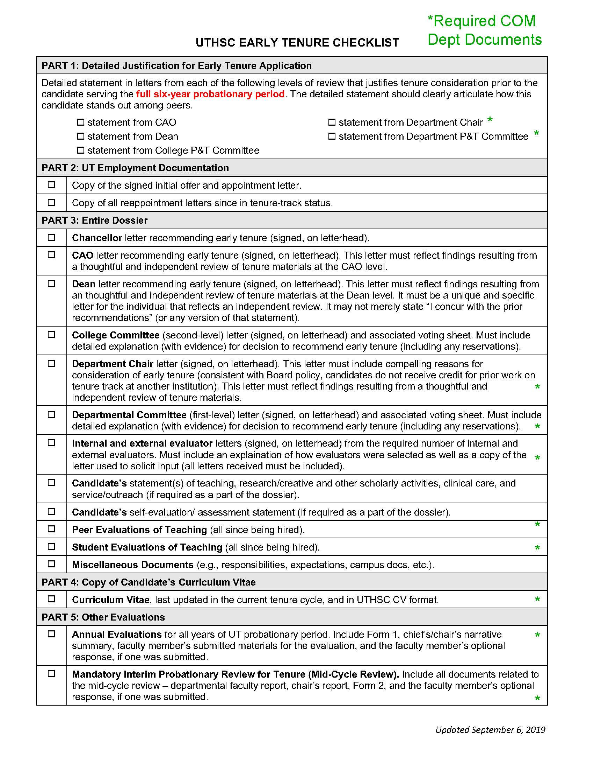
Extra Documents Required
For Early Tenure at Department Level
Interim (AKA MidTenure) Review
Annual Reviews for all years while on tenure track
Documentation on Student Evaluation of Teaching
Peer Evaluation of Teaching
Department P&T Letter must have explanation/evidence for basis of decision for early tenure – “Why are they a rock star?”
Chair Letter must have explanation/evidence for basis of decision for early tenure – “Why are they are rock star?”

Slide 24
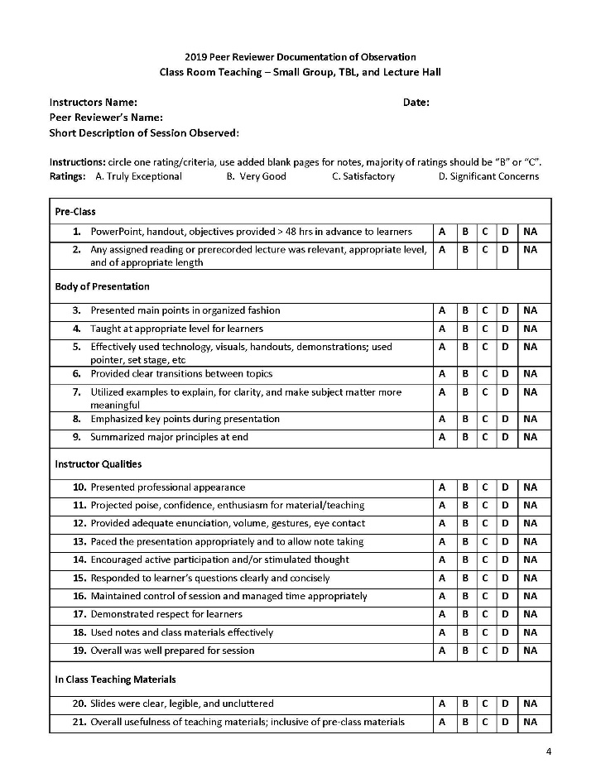
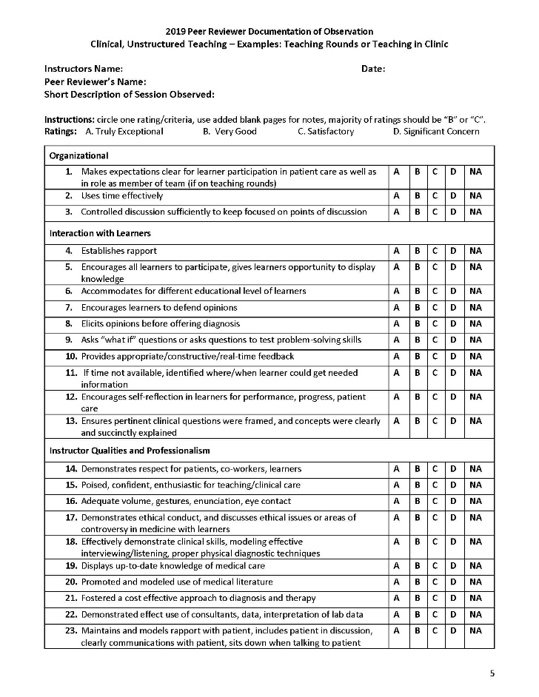
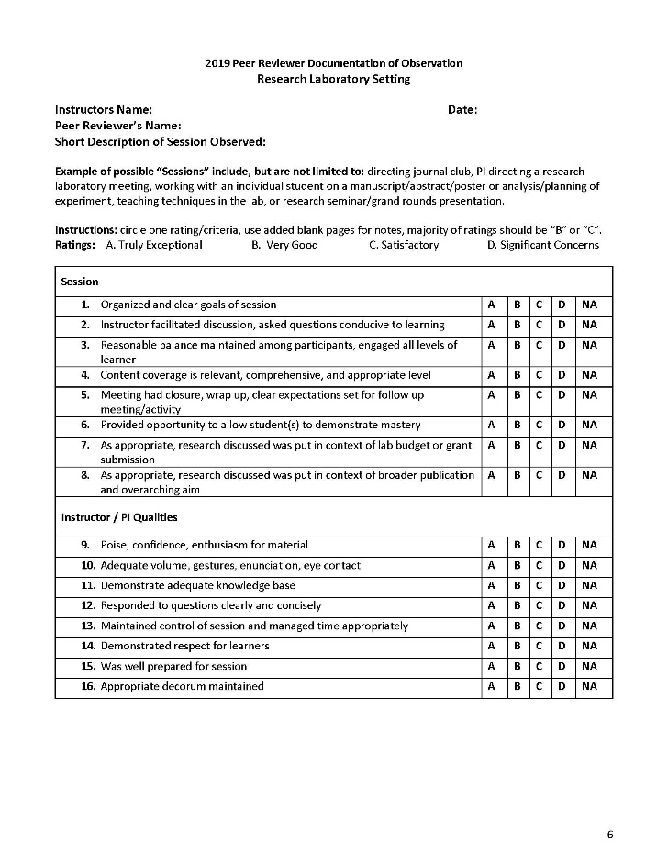
PEER REVIEW OF TEACHING
  2 completed forms required
  COM By-Laws Section 4: Peer Review of Teaching

Slide 25
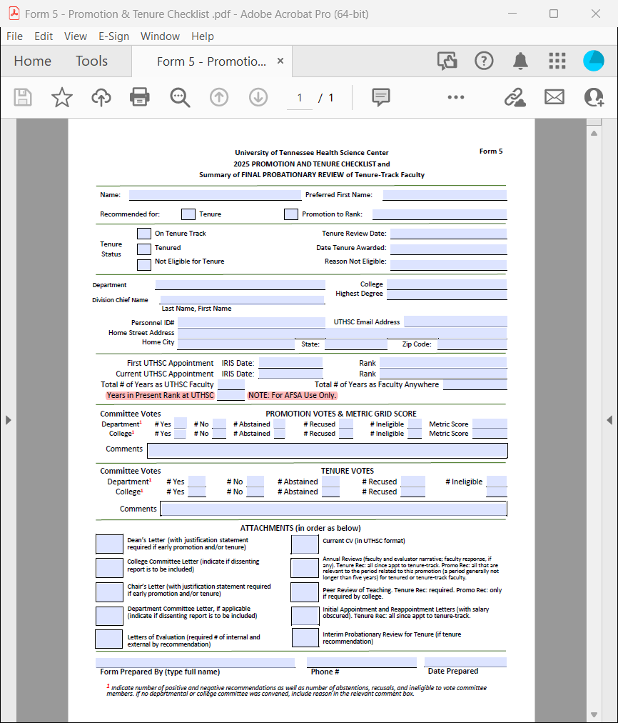
Form 5 – P&T Checklist

Slide 26
Promotion Metric
For Paid Faculty with % Efforts
One score is required from Department; completed by Department P&T
If there is no department committee, metric must be submitted by department chair
If % effort has changed over the years in rank, provide documentation of revised effort. But be sure Department P&T committee recognizes ALL the faculty has done
Effort must be included in Chair’s letter and match the metric submitted by the Department Committee
Effort totals equal 100%
FORMs: Promotion Metric Instructions
Promotion Metric Matrix (Interactive Form 10)

Slide 27
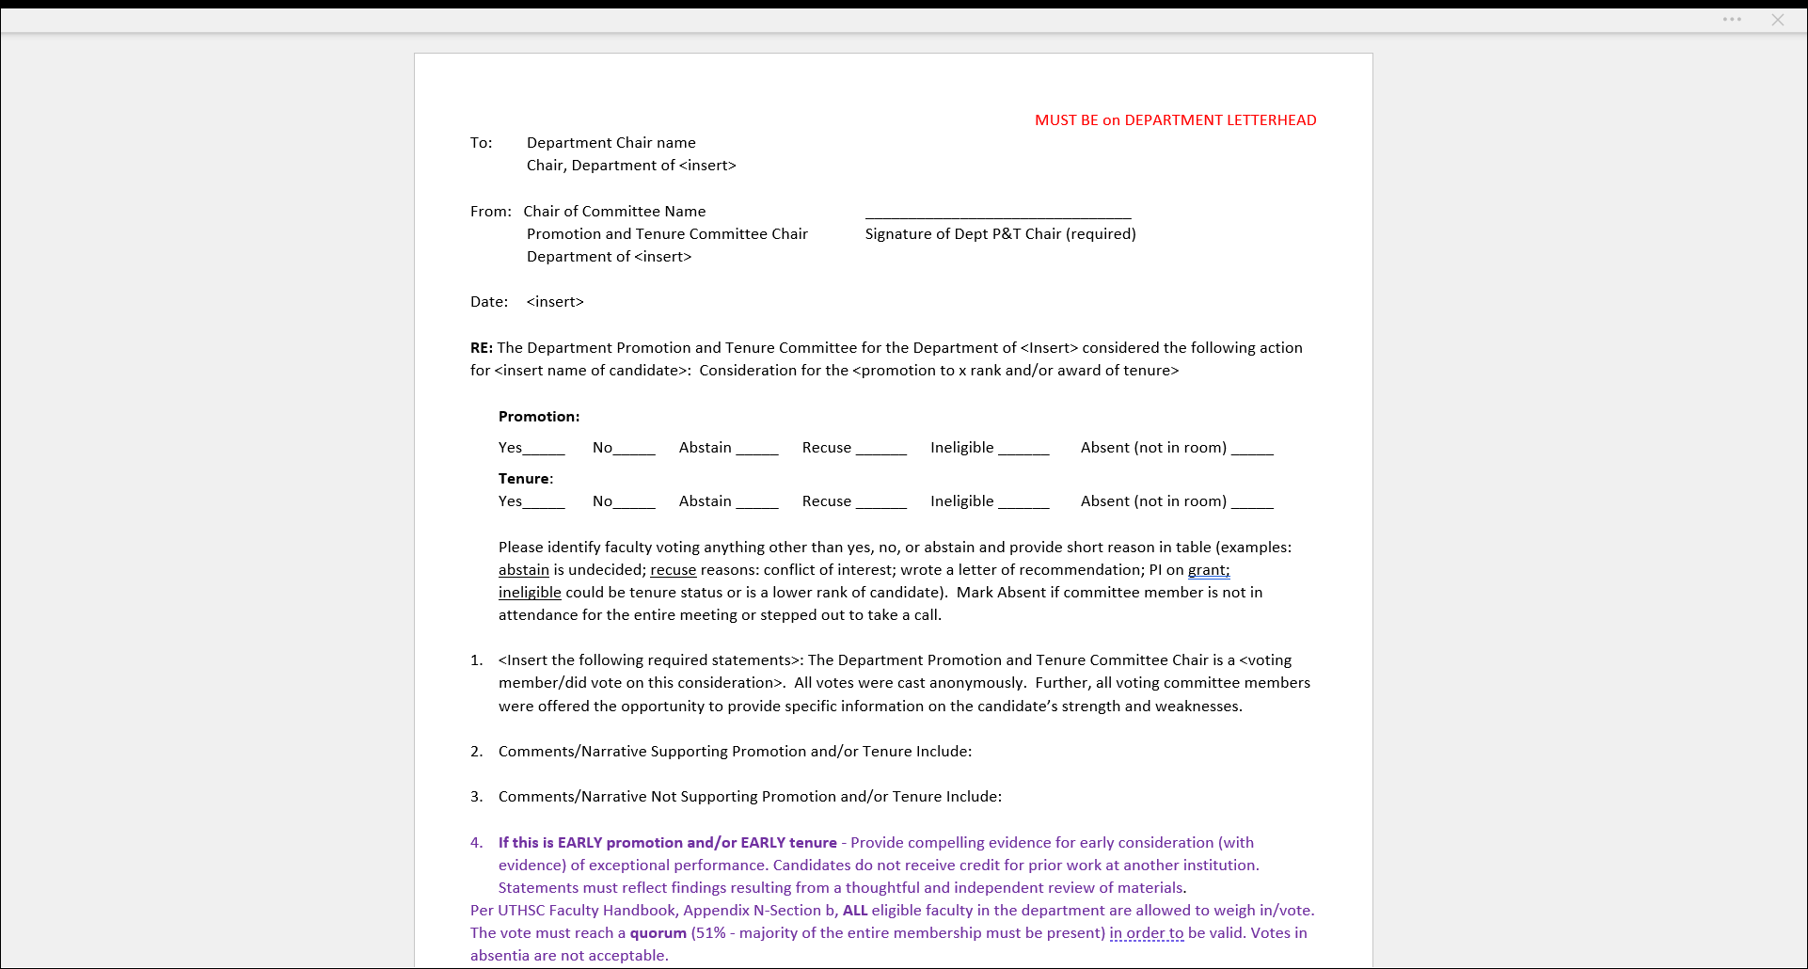
Department
Committee Report (pg 1)

Slide 28
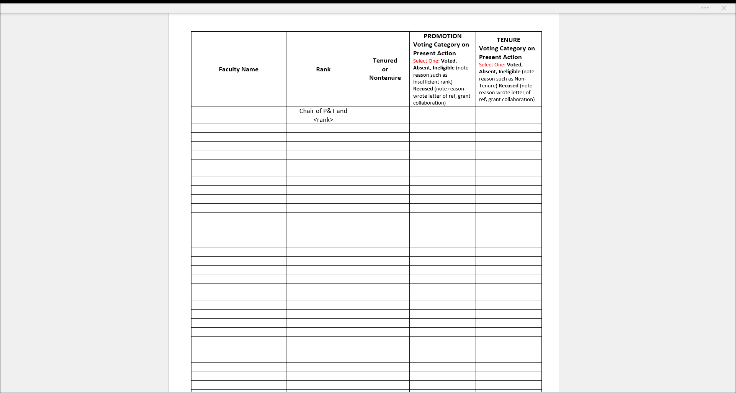
Department
Committee Report (pg 2)

Slide 29
Joint Appointments
Promotion in joint departments are not automatic
Candidate should reach out to Chair in which they have joint appointment. Provide current CV and request letter of support – this letter is considered a Chair’s letter and does not count as an internal letter
Joint appointment in another College can use the dossier for the other college with letter from Chair in COM and Dept P and T vote as long as the elements contained in the dossier meet the COM requirements ( ie # LOR, Peer Review of Teaching)

Slide 30
Additional Reference Material
UTHSC Faculty Handbook
Appendix N for Promotion (UTHSC Faculty Handbook)
Appendix L for Tenure (UTHSC Faculty Handbook)
College of Medicine Bylaws
College of Medicine Guide for Promotion & Tenure

Slide 31
Common Issues Noted by CAPT Committee
CV not in UTHSC format - Include effective date of faculty appointment
Personal Statement of candidate included (Not required, but helpful)
% effort not provided in Chair letter
Lack of clinical supporting information for those who are on the clinician educator track
  Meet/exceed RVU goals stated explicitly
  Develop clinical/quality/safety signature programs
  Develop clinical guidelines for their hospitals
  Consultation volume/scope/impact
For Research track, specifics include
  Dates of grant activity
  % salary carried on grants
  Specific information concerning patents

Slide 32
Chair Letter “If - Thens”
If early promotion and/or early tenure, then must have detailed justification as to why.
If department faculty vote was not unanimous, then must suggest possible explanation.
If tenure-track went longer than 6 years, then must provide explanation.
If some of the “time in rank” credit was at another institution, then must confirm faculty candidate did X years at X institution at the rank of X.
If there is no department P&T committee vote, then must provide justification as to why.
If there has been a major change in the effort allocation of the faculty candidate over the years, then the letter should note as much to better explain productivity in the various missions.
REQUIRED cc’s to Chair letter:
  Faculty Candidate
  Chair of Department Promotions and Tenure Committee

