Slide 1
Chronic Kidney Disease in Elderly
Adnan Naseer, M.D.
Assistant Professor of Medicine
Division of Nephrology
University of Tennessee, Memphis

Slide 2
Outline
Epidemiology of chronic kidney disease in elderly
Aging and kidney
Outcomes in chronic kidney disease and end stage renal disease in elderly
Management strategies in elderly with chronic kidney disease
Palliative care and chronic kidney disease

Slide 3
The Graying of America
According to US Census Bureau projections, the elderly population will more than double between 2000 and 2030, growing from 35 million to over 70 million.
Much of this growth is attributed to the "baby boom" generation which will enter their elderly years between 2010 and 2030.
Source of data: U.S. Census Bureau, “65+ in the United States: 2005,” December 2005.

Slide 4
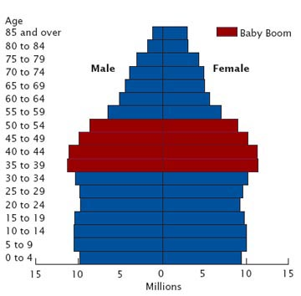
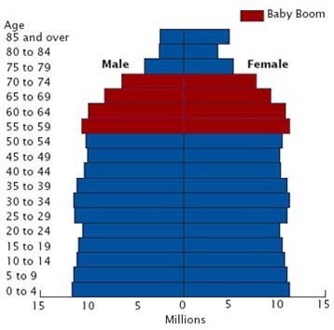
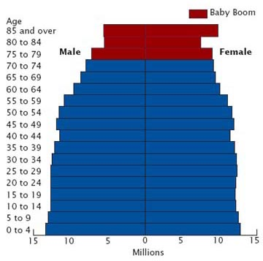
U.S. Population Pyramids
2000
2020
2040
Source of charts: U.S. Census Bureau, “65+ in the United States: 2005,” December 2005.

Slide 5
The Oldest Old
The "oldest old" – those aged 85 and over – are the most rapidly growing elderly age group.
The oldest old represented 12.1% of the elderly population in 2000 and 1.5% of the total population. In 2050, they are projected to be 24% of elderly Americans and 5% of all Americans.

Slide 6
Increases in the Oldest Old
U.S. Population Aged 85+ (in millions)
Sources of data: U.S. Census Bureau, “65+ in the United States: 2005,” December 2005; U.S. Census Bureau, U.S. Interim Projections by Age, Sex, Race, and Hispanic Origin, 2004.

Slide 7
In United States,
people >65 years of age have an average of
3.5 chronic illnesses
per person

Slide 8
Chronic Health Problems
Percent of 65+ with selected conditions, 2003-2004
Source of data: U.S. Census Bureau, Older Americans Update 2006: Key Indicators of Well-Being, May 2006.

Slide 9
Chronic Kidney Disease an Epidemic

Slide 10

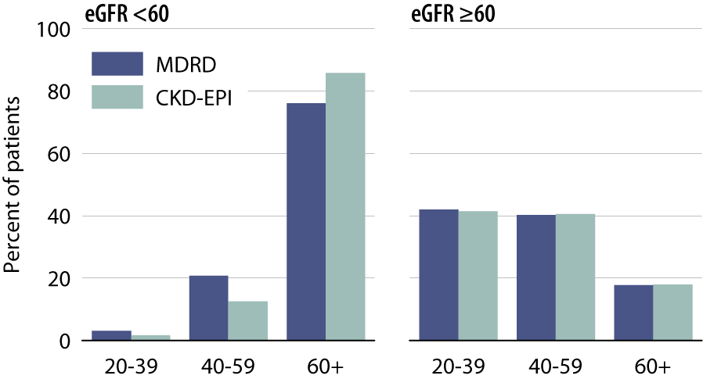
Distribution of NHANES 1999–2006 participants, by eGFR & method used to estimate GFR
USRDS 2010 ADR

Slide 11
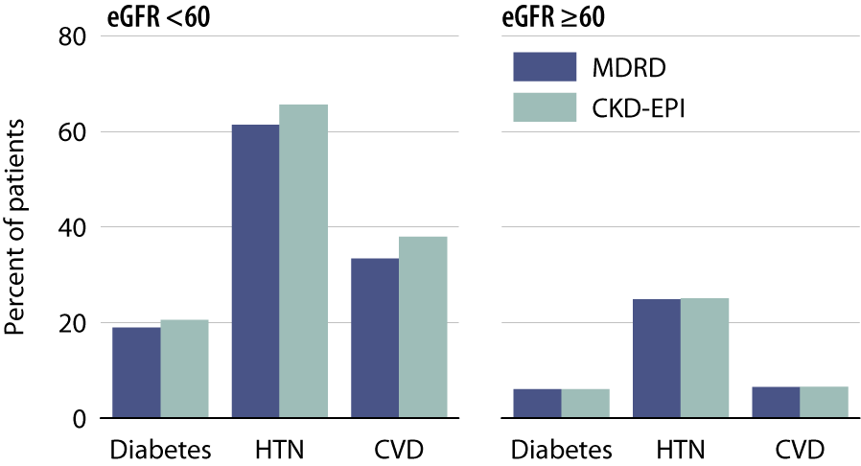
Prevalence of comorbidity in NHANES
1999–2006 participants, by eGFR
& method used to estimate GFR
USRDS 2010 ADR

Slide 12
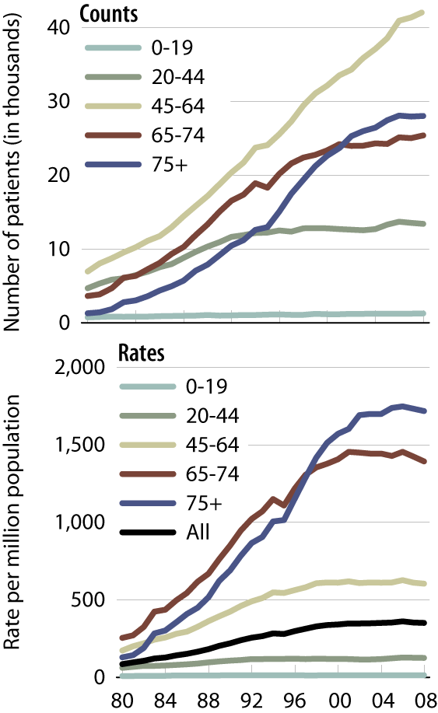
Incident counts
& adjusted rates,
by age
Incident ESRD patients; rates
adjusted for gender & race.
USRDS 2010 ADR

Slide 13
50% of Americans over 69 have CKD

Slide 14
Prevalence of Moderate CKD by Age Group (NHANES)
37%
27%
Coresh et al., JAMA 2007;298(17):2038-2047

Slide 15
Prevalence of CKD in U.S. 2000 Census
GFR (mL/min/1.73 m²) | 59-30 | 29-15
Number of People | 15.5 Million | 0.7 Million
Thus, about 16 million Americans have a GFR less than 60 mL/min/1.73 m². Plus 10 million more have a GFR over 60 but have persistent albuminuria.
Coresh, et al., 2007

Slide 16
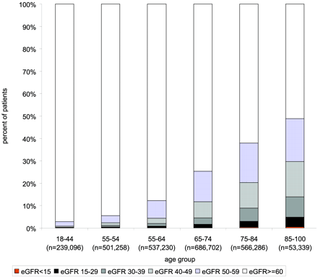
Prevalence of Low eGFR by Age Group Among US Veterans
Ann M. O’Hare et al JASN 2007

Slide 17
Why Chronic Kidney Disease
is So Prevalent in Elderly?

Slide 18
Age related changes in GFR
  Increasing longevity
Epidemic of DM, HTN, CVD and Obesity
Automatic reporting of eGFR
  Increasing awareness

Slide 19
Kidney and Aging

Slide 20
Aging Related Changes
Anatomic Changes
  Loss of renal mass; 10% reduction per decade. Wt of kidney 400 g at 4th decade, 200 g at 8th decade.
  Glomerulosclerosis, predominantly cortical nephrons.
  Tubulointerstitial fibrosis.
Renal blood flow
  Progressive reduction in renal plasma flow from 600 ml/min to 300 ml/min by age 80.

Slide 21
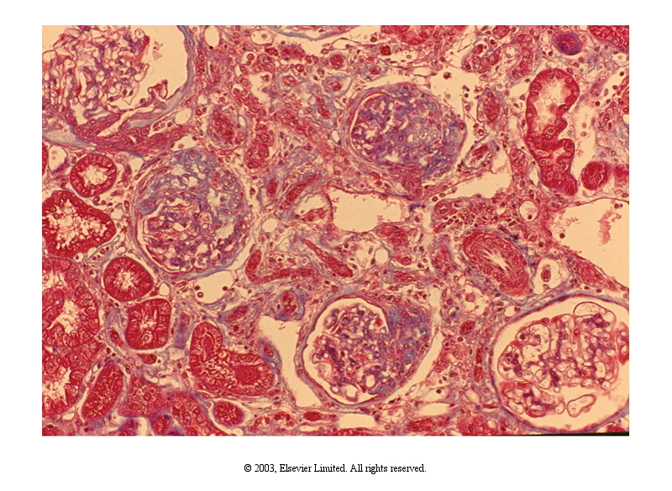

Slide 22
Effect of Age on eGFR
The “normal” eGFR is age-related
In normal “healthy” individuals, the eGFR will fall by one percent for every year after 40 years of age
An 80 year old man will have an expected eGFR of 50-60 ml/min

Slide 23
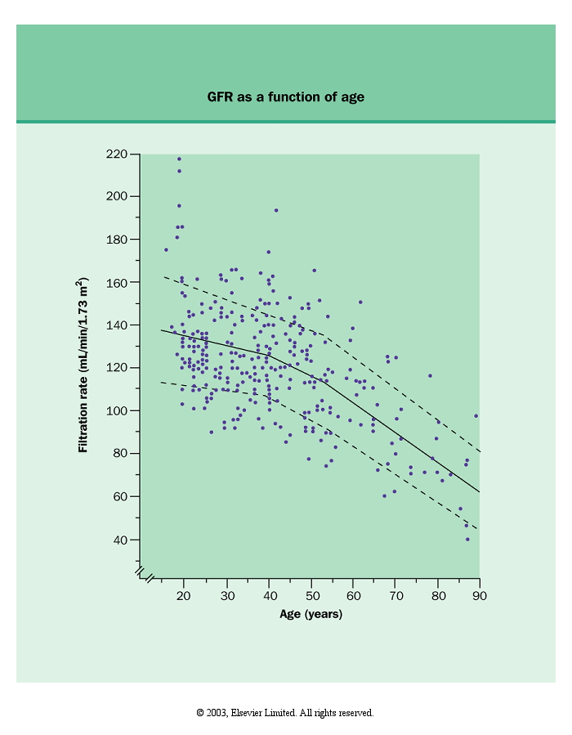

Slide 24
GFR Does Not Always Decline With Age

Slide 25
Baltimore Longitudinal Study of Aging
1958-1981
446 volunteers age 22 to 97 years old
Observed decline of 8.0 ml/min per 1.73 m²/decade of life.
One third of subjects did not have decline in GFR.
Lindeman RD et al., J Am Geriatr Soc 1985;33:278-285.

Slide 26
Progression and Outcomes in CKD

Slide 27
CKD Epidemic
Millions of individuals
26.3
Stages 1-4
0.5
Stage 5

Slide 28
Adjusted Risk of Mortality for eGFR <60 in adults >65 years
Adjusted for ACR
Adjusted for Dipstick Protein
Reference: eGFR 95 ml/min
CKD Prognosis Consortium, Lancet, 2010

Slide 29
CKD leads to CVD
Adjusted Hazard Ratio
for CVD Events
eGFR ml/min/1.73 m²
Go A, et al. NEJM 2004;351:1296-1305

Slide 30
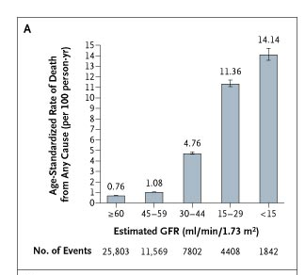
CKD and Risk of Death
Go A, et al. NEJM 2004;351:1296-1305

Slide 32
Age affects Outcomes in CKD
All patients with eGFR <60 in the year following October 1, 2000 who had an additional eGFR <60 in the previous 3 months
Creatinine and outcomes were followed for up to 4 years
209,622 veterans with stage 3-5 CKD
Mean age 73, 47% over 75
O’Hare , A. M. et al. J Am Soc Nephrol 2007;18:2758-2765

Slide 33
Absolute risk of ESRD decreases with age among patients with similar level of eGFR

Slide 34
“Progression of kidney dysfunction in the
community-dwelling elderly”
All subjects > 66 years old, two years of follow-up
1% reached ESRD, of which 93 % came from group with eGFR < 30
Hemmelgarn et al, KI 2006

Slide 35
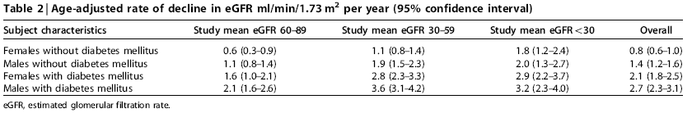
Cont’d

Slide 36
Risk Factors for Progression of CKD
Diabetes Mellitus
Hypertension
Proteinuria
Advanced CKD (eGFR <30 ml/min)
Male gender
Minority race

Slide 37
Which individuals with
abnormal eGFR should we
worry about?
Those with very poor kidney function for age
Those with deteriorating kidney function
Those who may have reversible/treatable cause (unexplained proteinuria/hematuria)
Those with functional consequences of CKD (anemia, renal bone disease, persistent hyperkalemia)

Slide 38
Management of CKD
Few randomized control trials to support specific management strategies
Most trials excluded or very few patients >70 years old
Results of RCTs may not be generalizable to older patients
  Differences in progression of CKD, development of ESRD and death
  Greater burden of co-morbidities, dementia, frailty
Current guidelines advocate “Age Neutral” approach
Care of elderly CKD patients should be individualized and integrated with patient preferences

Slide 39
Therapeutic Intervention in CKD
Advice to reduce cardiovascular risk (weight, smoking, diet, lipids etc)
Tight BP control (more stringent target if Proteinuria)
ACE-inhibitors & ARBs (check eGFR and K⁺ 7-10 days later)
Anemia management
Bone disease

Slide 40
ESRD in Elderly
Frequent co-morbidities: CVD, malnutrition
Disabilities: physical, cognitive, hearing, visual
Nursing home care
Higher mortality: mean survival for patients older than 75 years on RRT is 31 months

Slide 41
Survival in ESRD Patients Over 75 Years Old
Patients >75 yrs Survival rates at 1 and 3 years 80% and 45%
Patients 50-60 yrs Survival rates at 1 and 3 years 93% and 74%
Cumulative survival in two groups of hemodialysis patients: A represents patients between 50 and 60 years old. B represents patients above 75 years old. January 1996 to December 2000.
Leblanc et al. Am J Nephrol. 2003 Mar-Apr;23(2):71-7

Slide 42
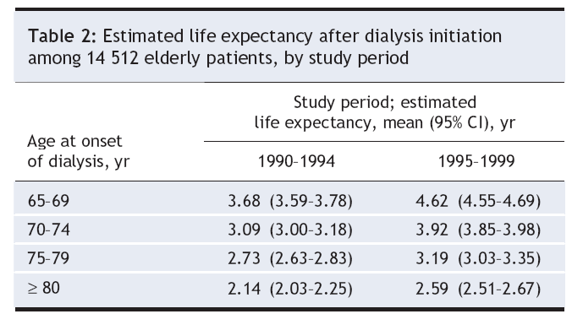
Changes in Survival Among Elderly ESRD Patients
CMAJ October 2007, Jassal et al, CORR data

Slide 43
Dialysis or not?
A comparative survival study of patients over 75
years with chronic kidney disease stage 5
Retrospective analysis of 129 patients , Follow-up ~570 days
Murtagh et al, Nephrology, Dialysis Transplantation 2007

Slide 44
Survival With and Without Dialysis
Murtagh et al, Nephrology, Dialysis Transplantation 2007

Slide 45
Kaplan-Meier survival curves in high co-morbidity only patients
Murtagh et al, Nephrology, Dialysis Transplantation 2007

Slide 46
Estimating Prognosis in ESRD Patients

Slide 47
Mortality Risk Factors in ESRD
Age
Malnutrition
Comorbidities
Functional status

Slide 48
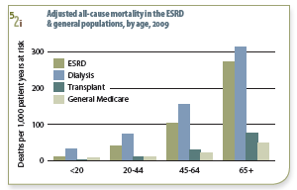
Age as Risk Factor for Death
  3-4% increase in death rate for each one year increment in age beginning at age 18.
2011 USRDS Annual Data Report

Slide 49
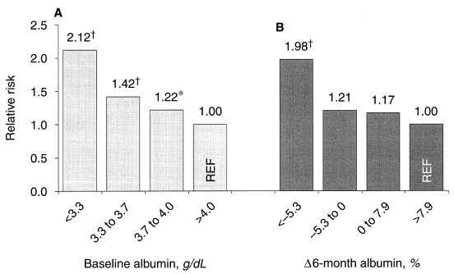
Malnutrition and ESRD
Relative risk of mortality and quartiles of serum albumin. Adjusted for baseline albumin (A), ∆albumin (B)
Pifer et al. DOPPS Kidney Int 2002;62(6):2238-45

Slide 50
Functional Status and ESRD
Poor functional status is highly predictive of early death (RR 1.5 to 3.0)
Measures of functional status
  Ability to ambulate (yes/no)
  Karnofsky scale
  Activities of daily living
  Inability to transfer and falls are indicators of poor prognosis

Slide 51
Comorbiditiy and ESRD
DM, CHF, CAD, PVD, COPD, malignancy
Comorbidity scores
  Charlson Comorbidity Index
  ESRD (Modified Charlson) Comorbidity Index

Slide 52
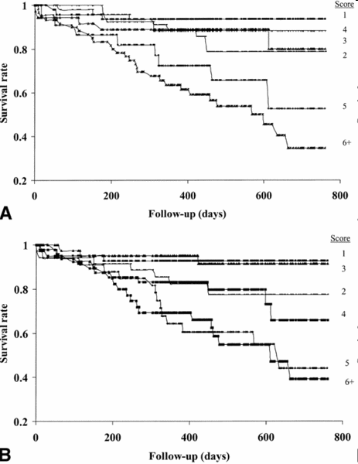
Adapting Charlson Comorbidity Index for ESRD Patients
(A) ESRD Comorbidity Index score
(B) Charlson Comorbidity Index score
Kaplan-Meier Survival Plots
Hemmelgarn et al. AJKD, 42(1), 2003: 125-32

Slide 53
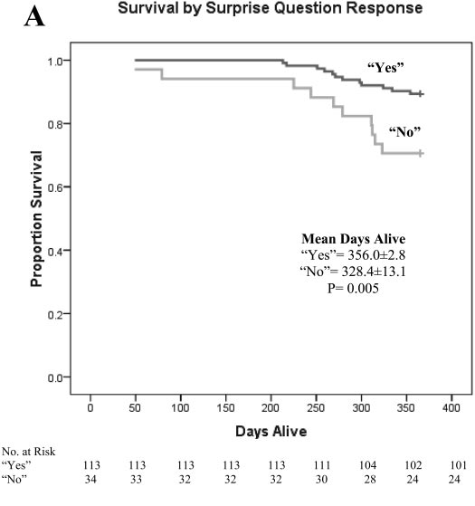
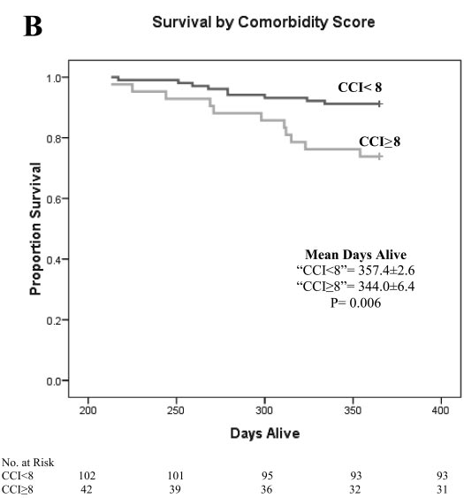
The “Surprise” Question
“Would I be surprised if this patient died in the next 12 months?”
Moss et al. Clin J Am Soc Nephrol; 3: 1379-84, 2008

Slide 54
Predicting Who Will Die Within First Year on Dialysis
  An integrated mathematical prognostic model takes into account:
  Clinician’s estimate of prognosis
  Laboratory values
  Comorbidities
  Functional status

Slide 55
HD Mortality Predictor
Mathematical model for estimating patient survival at 6 months using
  The “Surprise” question
  Serum albumin
  Age
  Presence or absence of dementia and PVD
  http://touchcalc.com/calculators/sq
Cohen et al, Clin J Am Soc Nephrol 2010; 5(1):72-9

Slide 58
Palliative Care
Definition
Palliative care is comprehensive, interdisciplinary care of patients and families facing a chronic or terminal illness focusing primarily on comfort and support.
Billings JA. Palliative Care. Recent Advances. BMJ 2000:321:555-558.

Slide 59
Aspects of Palliative Care
Pain and symptom management
Advance care planning
  DNR
  Advance Directives
Psychosocial and spiritual support

Slide 60
When is Palliative Care Needed?
Around the decision to stop dialysis
At the onset of conservative management
When symptoms from co-morbid conditions are severe
At times of crisis e.g. new diagnosis of malignancy, or acute severe symptoms
Patients who develop renal failure as a consequence of other life threatening conditions or its treatment e.g. cancer

Slide 61
Criteria for Withholding Dialysis
Patient or surrogate wishes
Profound neurologic impairment
  Persistent vegetative state, stroke, dementia
Non-renal terminal condition
  Malignancy, end-stage liver, heart, lungs
Medical condition that precludes process of dialysis
  Age, per se, is not a criterion to withhold dialysis

Slide 62
Symptoms During Last 24 Hours
N=79
Symptom | % present
Pain | 42
Agitation | 30
Myoclonus/twitching | 28
Dyspnea/agonal breathing | 25
Fever | 20
Diarrhea | 14
Dysphagia | 14
Nausea | 13
Cohen et al. AJKD, 2000;36:140-144

Slide 63
RPA/ASN Statement
on Quality Care at the End of Life

Slide 64
RPA/ASN Statement on Quality Care at the End of Life
Recommendations
1. All members of the renal health care team including nephrologists, nephrology nurses, nephrology social workers, and renal dietitians should obtain education
and skills in the principles of palliative care to ensure that ESRD patients and families receive multidimensional, compassionate, and competent care at the end of life.

Slide 65
RPA/ASN Statement on Quality Care
at the End of Life
2. In responding to an ESRD patient/surrogate decision to forgo dialysis, the nephrologist is obligated to determine, if possible, why the patient/surrogate has decided to forgo dialysis … Once the nephrologist is satisfied that the patient’s decision to forgo dialysis is informed and uncoerced, the nephrologist should respect the wishes of the patient/surrogate.

Slide 66
RPA/ASN Statement on Quality Care
at the End of Life
3. After a decision is made to forgo dialysis, the renal team should refer the patient to a hospice or adopt a palliative care approach to patient care. In either case, the nephrologist and other members of the renal team should remain active in the patient’s care to maintain continuity of relationships and treatment.

Slide 67
RPA/ASN Statement on Quality Care
at the End of Life
4. Nephrologists and other members of the renal team should obtain education and skills in advance care planning so that they are comfortable addressing end-of-life issues with their patients.

Slide 68
Exposure to Palliative Care
 | Geriatrics | Critical Care | Nephrology
Completed a Rotation Focused on Palliative Care | 71% | 2% | 1%
Had Contact with Palliative Care Specialist | 80% | 46% | 45%
Quality of teaching with respect to end-of-life care rated ‘very good’ or ‘excellent’ | 53% | 34% | 15%
Holley et al. Am J Kidney Dis 42(4):813-820, 2003.

Slide 70
Clinical Scenario
Age 85
eGFR 30
Congestive heart failure, unable to manage stairs
No proteinuria

Slide 71
Cont’d
This patient is likely to have a cardiorenal syndrome
Evidence of progression?
  if not, conservative management
  if so, is there any prospect of reversibility (in this case probably not) or would the patient tolerate/ benefit from renal replacement therapy (in this case probably not)
Palliative care pathway

Slide 72
Summary
Assess risk for CKD progression
  Serial eGFR
  Proteinuria and other risk factors
Assess CV risk
  As per high risk group guidelines
Assess for CKD complications
  Anemia
  Bone disease
  Malnutrition
Assess for renal replacement VS Non-dialytic therapy
Assess for palliative care

