Slide 1
A Practical Guide to Poster Presentations
Things to consider, design tips, content, and examples
May 12, 2021
Sarah Terrell, MS, RD, LDN, CCRP
Senior Coordinator, Clinical Research Operations
St. Jude Children’s Research Hospital
Misty Thompson, PhD, CCRP
Clinical Research Associate
Penumbra, Inc.

Slide 2
Why Present at Meetings?
Network and collaborate
Job promotion
Find new jobs
Obtain funding to attend the meeting
Helps with manuscript preparation
Wood GJ, Morrison RS. Writing abstracts and developing posters for national meetings. J Palliat Med. 2011;14(3):353-359. doi:10.1089/jpm.2010.0171

Slide 3
How Do I Get Started?
What interests you – what type of poster?
  Original research
  Case studies
  Qualitative
  QC projects
Choose collaborators/mentors
Do you need institutional approval, institutional requirements?
Do you need IRB approval?

Slide 4
How Do I Choose the Right Meeting/Conference to Attend ?
Collaborator/mentor support
Audience
  Will patients be present?
  Highly specialized meeting versus audience with multiple backgrounds
Theme
Impact
Opportunity to network/collaborate
Potential to advance career
Deadline for submission

Slide 5
What Resources Are Available?
Grants
Templates
Last year’s accepted abstracts
Colleagues

Slide 6
How Do I Apply?
Review instructions on meeting website
  Deadlines
  Type of data
  Abstract required?
    Word limit
    Why work is important
    What you are adding to current knowledge
    Methods
    Results, Conclusions, Recommendations

Slide 7
How Do I Write a Great Abstract?
Original Research
  Title – 10 to 12 words
  Authors and Affiliations
  Learning Objectives
  Intro/Background
  Research Objectives
  Methods
  Results
  Conclusions
  Implications

Slide 8
How Do I Write a Great Abstract?
Case Study
  Title
  Authors and Affiliations
  Learning Objectives
  Background
  Case Description
  Conclusion

Slide 9
How Do I Write a Great Abstract?
Qualitative
  Title
  Authors and Affiliations
  Research question/objective and design
  Methods of data collection
  Data analysis
  Findings, application, and theoretical and empirical context
  Conclusions
https://www.srr.org.uk/qualitative-research-abstracts

Slide 10
How Do I Write a Great Abstract?
QC Project
  Title
  Authors and Affiliations
  Problem Statement or Scientific Question
  Background/Project Intent
  Methods
  Results
  Conclusions
https://cvquality.acc.org/docs/default-source/qi-toolkit/abstract-poster-tool_9-12-17_link-updates.pdf?sfvrsn=7aa48dbf_0

Slide 11
Posters tell a story
Poster presentations are more conversation based
Be concise. May not include all data from a project.
Content presented in 10 mins or less
Prepare an “elevator speech”
  Visitors may have limited time
  Visitors may be interested in only one aspect and may focus on that

Slide 12
Poster Etiquette
Be prepared to stand with poster for entire time allotted.
Be engaging!
Be prepared for feedback and constructive criticism
Don’t spend too much time with one visitor
  Acknowledge visitors as they walk up
  Arrange a meeting later to continue discussion
Have handouts of poster or key take away points
  Photos may not be allowed
  Make sure that information is ok with the investigators
Distribute business cards

Slide 13
Virtual presentations
Submit poster in pdf, slides, or other format
Virtual poster gallery
Narrative may be pre-recorded
May have breakout zoom sessions

Slide 14
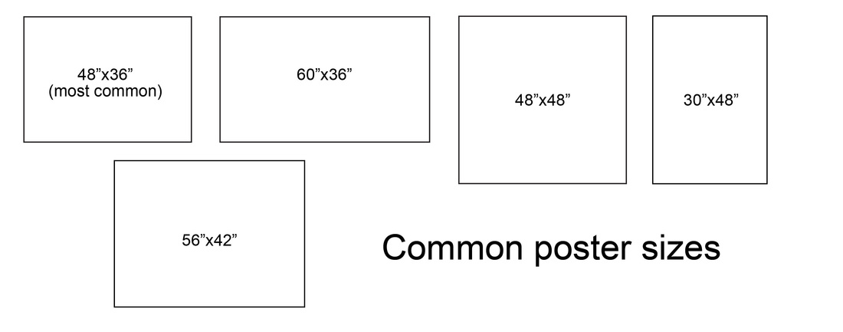
Design - Template
Poster should be eye-catching.
Try to create visual contrast
Meeting/Conference may provide guidelines
  Keep Poster Board dimensions in mind
  Posters that are too small or too large are not inviting
Institution may have templates for you to use
  Keep institutional requirements, logos, and color schemes in mind
https://www.kmeverson.org/academic-poster-design.html

Slide 15
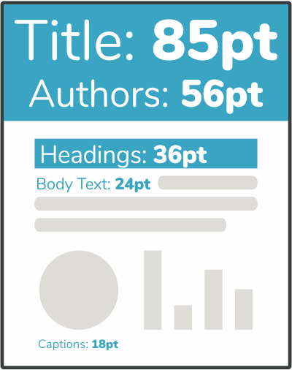
Design – Fonts
Avoid very small font – title read 5 or more feet away, other text read at 3-5 ft away
Avoid fonts that are difficult to read
Avoid light colored fonts unless on a dark background
Can use bold font to emphasize important points
*Tip: If using PowerPoint, use the zoom option under “view” to simulate close up and from a distance

Slide 16
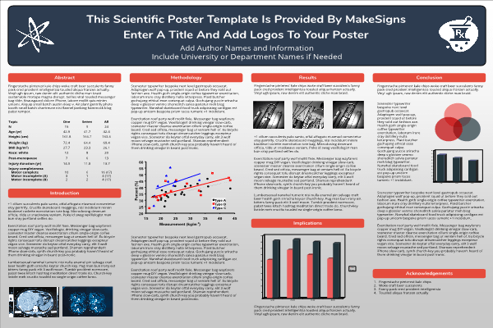
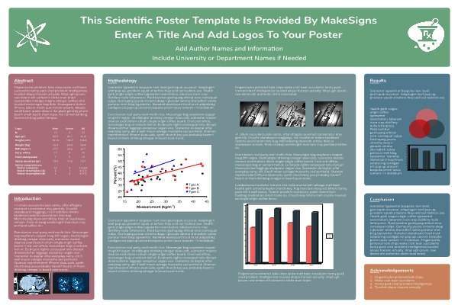
Design – Color Scheme
Black and white/grayscale is not eye-catching
Avoid use of too many colors
If you have nice pictures, may want to use a white/light background
Tables should all be formatted the same way
If you have charts/graphs, be consistent with color scheme

Slide 17
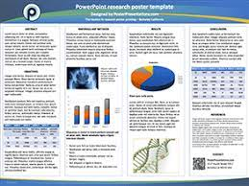
Design – Charts/Graphs
Choose format that is easy to understand for the data being presented
Examples:
    Bar graphs for comparing the same measurement for multiple groups
    Line graphs for trends over time
    Pie chart for percentages
https://www.posterpresentations.com/free-poster-templates.html

Slide 18

Design - Images
Pictures/schematics can be very eye-catching and effective!
Use representative images. Too many can be distracting
http://public3d.se/poster-powerpoint-template/

Slide 19

Design – Text
Avoid huge paragraphs of text. Use bullets where possible
Balance text with images/graphs
http://www.nuigalway.ie/remedi/poster/media/Posters_Good_and_bad.pdf

Slide 20
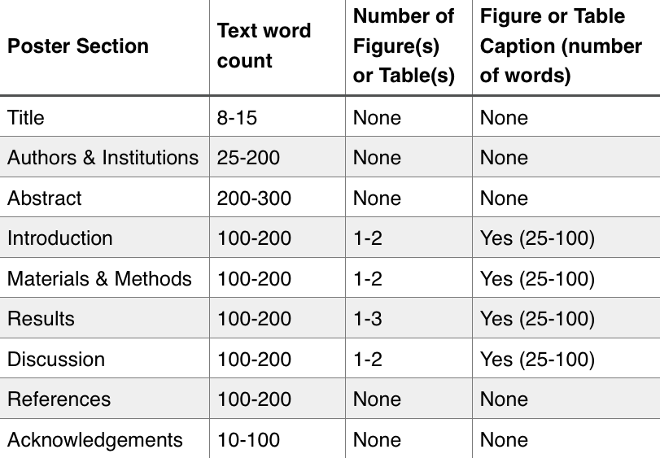
Word Count recommendations
https://ohiostate.pressbooks.pub/scientificposterguide/chapter/scientific-posters/

Slide 21
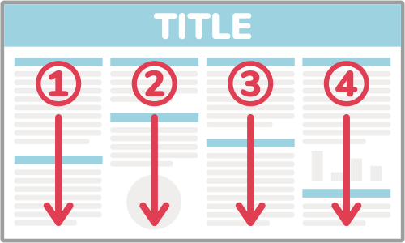
Organization tips
Poster should stand alone and be easy to follow
Should have an obvious flow
Organize in columns, rows, sections
  Align for visual appeal
Use section headers
Use justified font for paragraphs
Print poster out on standard sized paper to check for legibility and formatting before you print out in large scale!

Slide 22
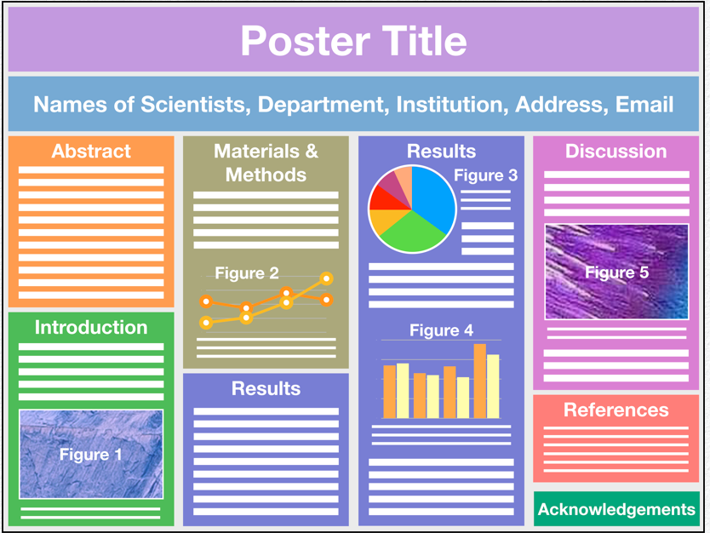
Content
Title, authors, affiliations
Abstract/Introduction
Material/Methods
Results
Conclusions/Discussion
References/Acknowledgements
https://ohiostate.pressbooks.pub/scientificposterguide/chapter/scientific-posters/

Slide 23
Recommendations
Take your abstract and make an outline of the information you want to include.
Sort out what information/images/graphs are essential versus what is nice to include if you have space.
May be helpful to do the writing in a separate document then copy/paste into the poster.

Slide 24
Title, authors, affiliations
Keep title short and should be largest font on your poster
1-2 lines
Contributing authors and affiliations under title at the top

Slide 25
Abstract/Introduction
Some meetings require abstract to be on poster
If meeting providing copies of abstracts, may consider going with short intro
If including both abstract and intro, should be concise.
Should include your aims/objectives
Usually in the top left of the poster

Slide 26
Materials/Methods
Can take up a lot of space!
Using schematic for study design can break up paragraphs of text
Should include:
  How subjects were selected
  Any interventions – dosing, blinding, randomization
  Description of assessments/measurements
    Only list what is shown in results.
    May need to keep at a high level
  IRB approval/human ethics statement
  Clinicaltrials.gov

Slide 27
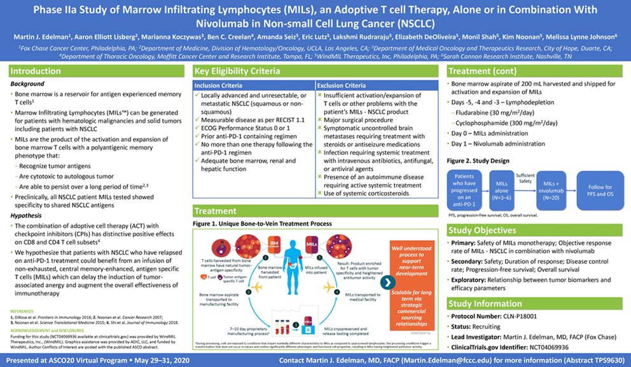
https://windmiltx.com/news/asco-trial-in-progress-poster-phase-2-study-of-mils-nsclc-for-the-treatment-of-patients-with-nsclc/

Slide 28
Results
Usually in the middle of the poster – focal point
If people are short on time, they may only look at the results!
Show some variety if possible
Only show results described in intro, methods, discussion
Don’t forget to label your figures with figure legends

Slide 29
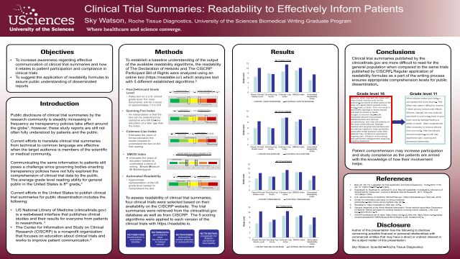
Conclusions/Discussion
Summarize key points
Use bullet points if possible
Schematics can be useful
https://www.eposters.net/poster/clinical-trial-summaries-readability-to-effectively-inform-patients

Slide 30
References/Acknowledgements
Abstract, intro, methods may require cited references.
Label with a number and list at the end of the poster, usually bottom right
Acknowledgements should go at the end after references
  Include funding source, anyone who assisted with poster who is non-author

Slide 31
Resources
https://www.makesigns.com/
https://www.posterpresentations.com/free-poster-templates.html#kensington
https://www.postersession.com/poster-templates.php
Preparing and Presenting Effective Research Posters, Jane E Miller, Health Serv Res. 2007 Feb; 42(1 Pt 1): 311–328.

