Slide 1

OSP and Me
June 2021 Updates
Office of Sponsored Programs

Slide 2

OSP Pre-Award Updates
NIH Bio Sketch
NIH Other Support
NIH eRA Commons IDs
New F&A rate Agreement
F&A rate reminders

Slide 3

NOT-OD-21-073 : Changes to Biosketch Format
NIH released NOT-OD-21-073 on March 12, 2021
https://grants.nih.gov/grants/guide/notice-files/NOT-OD-21-073.html
• Highlighted changes to the Biographical Sketch
Section B ‘Positions and Honors’ has been renamed ‘Positions, Scientific Appointments, and Honors’
For the Non-Fellowship Biosketch, Section D. has been removed
For the Fellowship Biosketch, Section D. has been updated to remove ‘Research Support’
As applicable, all applicants may include details on ongoing and completed research projects from the past three years that they want to draw attention to within the Personal Statement, Section A.

Slide 4
NOT-OD-21-073 : Changes to Biosketch Format
Updated instructions for the biosketch format include changes to the following sections:
A. Personal Statement
You may now include ongoing and completed research projects from the past three years you want to highlight. This section was entitled Research Support in the previous NIH biosketch format.
B. Positions, Scientific Appointments, and Honors
List, in reverse chronological order, (most recent 1st) all positions and scientific appointments both domestic and foreign, including affiliations with foreign entities or governments. Include titled academic, professional, or institutional appointments whether or not remuneration is received, and whether full-time, part-time, or voluntary (including adjunct, visiting, or honorary).
D. Scholastic Performance (fellowship-type biosketches: predoctoral, postdoctoral, diversity supplement candidates)
Note: Section D has been eliminated from the non fellowship biosketches. It is renamed on fellowship biosketches to Scholastic Performance, a section designed to highlight the students research support and scholastic accomplishments.

Slide 5
NOT-OD-21-073 : Changes to Biosketch Format
NIH BIOSKETCH SAMPLE
A. Personal Statement
I am an Associate Professor of Psychology, and my research is focused on neuropsychological changes associated with substance use disorders. I have a broad background in psychology, with specific training and expertise in ethnographic and survey research and secondary data analysis on psychological aspects of substance use disorders. As PI or co-Investigator on several university- and NIH-funded grants, I laid the groundwork for the proposed research by developing effective measures of disability, depression, and other psychosocial factors relevant to older people with substance use disorders, and by establishing strong ties with community providers that will make it possible to recruit and track participants over time as documented in the following publications. In addition, I successfully administered the projects (e.g. staffing, research protections, budget), collaborated with other researchers, and produced several peer-reviewed publications from each project. As a result of these previous experiences, I am aware of the importance of frequent communication among project members and of constructing a realistic research plan, timeline, and budget. The current application builds logically on my prior work. During 2015-2016, my career was disrupted due to family obligations. However, upon returning to the field, I immediately resumed my research projects and collaborations and successfully competed for NIH support. In summary, I have the expertise, leadership, training, expertise, and motivation necessary to successfully carry out the proposed research project.
Ongoing and recently completed projects that I would like to highlight include:
R01 DA942367
Hunt (PI)
09/01/16-08/31/21
Health trajectories and behavioral interventions among older people with substance use disorders
R01 MH922731
Merryle (PI), Role: co-investigator
12/15/17-11/30/22
Physical disability, depression, and substance use among older adults

Slide 6
NOT-OD-21-073 : Changes to Biosketch Format
NIH BIOSKETCH SAMPLE
A. Personal Statement (Continued)
Citations:
Merryle, R.J. & Hunt, M.C. (2015). Independent living, physical disability and substance use among older adults. Psychology and Aging, 23(4), 10-22.
Hunt, M.C., Jensen, J.L. & Crenshaw, W. (2018). Substance use and mental health among community-dwelling older adults. International Journal of Geriatric Psychiatry, 24(9), 1124-1135.
Hunt, M.C., Wiechelt, S.A. & Merryle, R. (2019). Predicting the substance use treatment needs of an aging population. American Journal of Public Health, 45(2), 236-245. PMCID: PMC9162292
Merryle, R. & Hunt, M.C. (2020). Randomized clinical trial of cotinine in older people with nicotine use disorder. Age and Aging, 38(2), 9-23. PMCID: PMC9002364

Slide 7
NOT-OD-21-073 : Changes to Biosketch Format
NIH BIOSKETCH SAMPLE
List the following in reverse chronological order (most recent 1st)
B. Positions, Scientific Appointments, and Honors
Positions and Scientific Appointments
2021– Present Associate Professor, Department of Psychology, Washington University, St. Louis, MO
2020 – Present Adjunct Professor, McGill University Department of Psychology, Montreal, Quebec, Canada
2018 – Present NIH Risk, Adult Substance Use Disorder Study Section, member
2015 – 2017 Consultant, Coastal Psychological Services, San Francisco, CA
2014 – 2021 Assistant Professor, Department of Psychology, Washington University, St. Louis, MO
2014 – 2015 NIH Peer Review Committee: Psychobiology of Aging, ad hoc reviewer
2014 – Present Board of Advisors, Senior Services of Eastern Missouri
2013 – 2014 Lecturer, Department of Psychology, Middlebury College, Middlebury, VT
2011 – Present Associate Editor, Psychology and Aging
2009 – Present Member, American Geriatrics Society
2009 – Present Member, Gerontological Society of America
2009 – 2013 Fellow, Intramural Research Program, National Institute on Drug Abuse, Baltimore, MD
2006 – Present Member, American Psychological Association
Honors
2020 Award for Best in Interdisciplinary Ethnography, International Ethnographic Society
2019 Excellence in Teaching, Washington University, St. Louis, MO
2018 Outstanding Young Faculty Award, Washington University, St. Louis, MO

Slide 8
NOT-OD-21-073 : Changes to Biosketch Format
What remains the same in a NIH biosketch?
• Personal Statement, Section A.,
Investigators may still cite up to 4 publications or research products that highlight experience and qualifications for the project.
• Contributions to Science, Section C.,
Investigators may still briefly describe up to five of their most significant contributions to science. For each contribution, they may cite up to four publications or research products that are relevant to the contribution.
Investigators may still provide a URL to a full list of their published work. This URL must be to a Federal Government website (a .gov suffix). NIH recommends using My Bibliography (NCBI). Providing a URL to a list of published work is not required. An example URL is shown below:
Complete List of Published Work in MyBibliography: https://www.ncbi.nlm.nih.gov/myncbi/1lCifFFV4VYQZE/bibliography/public/

Slide 9
NOT-OD-21-073 : Changes to Biosketch Format
Helpful Information
For Non-Fellowship and Fellowship Biosketch Format Pages, Instructions and Samples, go to https://grants.nih.gov/grants/forms/biosketch.htm.
The Non-fellowship and Fellowship biosketch templates, detailed biosketch instructions, and sample biosketches are available for download.
New biosketch format went into effect for due dates on or after May 25, 2021 and will become mandatory January 25, 2022. OSP encourages all investigators to begin using the new format now.
New and Resubmission Applications
Just in Time
Annual Progress Reports (RPPRs)

Slide 10
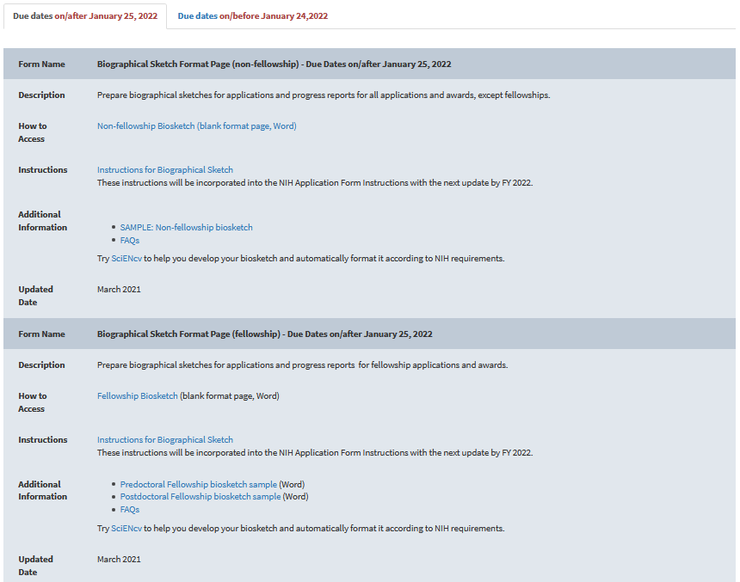
NOT-OD-21-073 : Changes to Biosketch Format
NIH Biosketch Format Pages, Instructions, and Samples
• https://grants.nih.gov/grants/forms/biosketch.htm

Slide 11
NOT-OD-21-073 : Changes to Other Support
Changes to Other Support
• In effect for all applications/submissions on/after May 25, 2021 including
new and resubmission applications
Just-in-Time
Annual and Final RPPRs
• Will be enforced for submissions on/after January 25, 2022
OSP encourages all Investigators to utilize the new format as soon as possible
Submissions not in compliance with new guidelines after January 25,2022 may be rejected without scientific review as non-compliant

Slide 12
NOT-OD-21-073 : Changes to Other Support
• Format:
Re-organized to separate funded projects from in-kind contributions.
• Signature Block Added:
PD/PI or Other Senior/Key Personnel electronically sign to certify the accuracy of the information submitted
Each PD/PI or senior/key personnel must sign their respective Other Support form as a PDF prior to submission
• Supporting Documentation Required:
Foreign activities/resources required copies of contracts/grants/other agreement specific to foreign appointments and/or employment with a foreign institution after Other Support pages
Note: If not in English, must provide translated copies

Slide 13
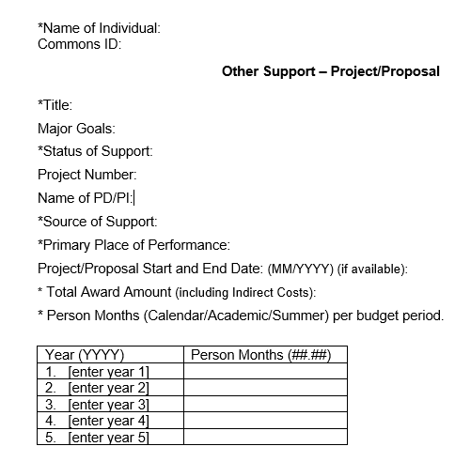
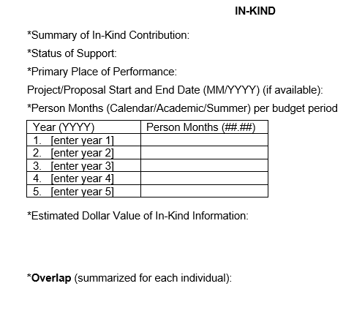
NOT-OD-21-073 : Changes to Other Support

Slide 14
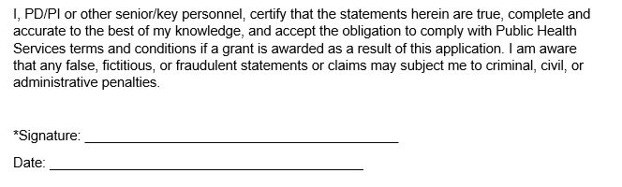
NOT-OD-21-073 : Changes to Other Support—NEW PI Certification

Slide 15
NOT-OD-21-073 : Changes to Other Support
Changes to Other Support- when to notify NIH
• Unchanged
During Just In Time submission
Annual RPPR submission
• Updated
Immediate notification of undisclosed Other Support outside of Just-in-Time or the RPPR, as applicable
If you become aware of any undisclosed Other Support at any point in the grant process, please contact OSP immediately to establish what needs to happen next

Slide 16
NOT-OD-21-073 : Changes to Other Support
What does Other Support include?
Other Support includes all resources made available to a researcher in support of and/or related to all of their research endeavors, regardless of whether or not they have monetary value and regardless of whether they are based at the institution the researcher identifies for the current grant.

Slide 17
What should be reported as Other Support?
Resources and/or financial support from all foreign and domestic entities, that are available to the researcher. This includes (but is not limited to):
Financial support for laboratory personnel
Provision of high-value materials that are not freely available (e.g., biologics, chemical, model systems, technology, etc.).
Consulting agreements, when the PD/PI or other senior/key personnel will be conducting research as part of the consulting activities.
In-kind contributions, e.g. office/laboratory space, equipment, supplies, or employees or students supported by an outside source. If the time commitment or dollar value of the in-kind contribution is not readily ascertainable, the recipient must provide reasonable estimates.

Slide 18
What is not required to be disclosed as Other Support?
Training awards, prizes, or gifts.
Gifts are resources provided where there is no expectation of anything (e.g., time, services, specific research activities, money, etc.) in return. An item or service given with the expectation of an associated time commitment is not a gift and is instead an in-kind contribution and must be reported as such
Institutional resources.
such as core facilities or shared equipment that are made broadly available, should not be included in Other Support, but rather listed under Facilities and Other Resources.
Non-research consulting activities.
Please note- Declaration of Other Support for NIH funding is not the same as UTHSC’s internal Outside Interest Disclosure Policy- Please refer to the Office of Institutional Compliance for more information regarding F10125- Conflict of Interest Policy

Slide 19
National Science Foundation [NSF]
NSF Pre-award and Post –award Disclosures
Relating to the
  Biographical Sketch and
  Current and Pending Support
NSF has developed a disclosure table entitled, NSF Pre-award and Post-award Disclosures Relating to the Biographical Sketch and Current and Pending Support, to identify where these disclosures must be provided in proposals as well as in project reports. Proposers and awardees may begin using this resource immediately to assist with completing the relevant proposal and project report sections. As a reminder, current and pending support information is used to assess the capacity of the individual to carry out the research as proposed, as well as to help assess any potential overlap/duplication with the project being proposed.
A revised Proposal and Award Policies and Procedures Guide (PAPPG) will be released in late June with an effective date of October 4, 2021, and the disclosures table will be included in this revised version. As noted above, however, proposers and awardees may begin using this table immediately.

Slide 20
NOT-OD-21-109: eCommons ID requirement update
Expanding Requirement for eRA Commons IDs to All Senior/Key Personnel
• Enforced on due dates on or after January 25, 2022
failure to include will prevent a proposal being successfully submitted to NIH
• submission “warnings”
for submissions after April 2021, applications not including eCommons IDs for all Senior/Key Personnel will trigger a “warning” at the point of submission
Note: Cayuse 424 is now showing a warning when eCommons ID is not provided for Key Personnel

Slide 21
NOT-OD-21-109: eCommons ID requirement update
Who needs an eCommons ID
• New or Re-Submission Proposals
- All PD/PI (including at subaward sites)
- All Senior/Key Personnel ( including at subaward sites)

Slide 22
NOT-OD-21-109: eCommons ID requirement update
Who needs an eCommons ID
• RPPRs
  All PD/PI (including at subaward sites)
  All Senior/Key Personnel ( including at subaward sites)
  Undergraduate
  Graduate Student
  Postdoctoral Fellows:
Post-Docs are required to complete their profile in eRA Commons before an RPPR can be submitted.
failure to do so frequently cause delays in RPPR submission.
Please contact OSP as soon as you become aware of a Post-Doc starting work on an active grant so an eRA Commons account can be established

Slide 23
Resources
• Full copies of NOT-OD-21-109 and NOT-OD-21-073
- https://grants.nih.gov/grants/guide/notice-files/NOT-OD-21-109.html
- https://grants.nih.gov/grants/guide/notice-files/NOT-OD-21-073.html
• Additional Information including Format Sheets, Full Instructions and Samples
- Bio Sketch : https://grants.nih.gov/grants/forms/biosketch.htm
- Other Support : https://grants.nih.gov/grants/forms/othersupport.htm
- NIH anticipates additional resources including training videos will be added to the above pages as they become available
Coming Soon
- NIH is finalizing the SciENcv template for Other Support - anticipated release early in FY 2022. Until released use Word Format page to prepare Other Support

Slide 24
UTHSC New
F&A Rate Agreement

Slide 25
On Campus F&A rate increase
UTHSC Memphis Has a new Facilities and Administrative Rate Agreement
Effective: July 1, 2021
2% increase for On-Campus Research new rate is 54%
OSP Webpage Link to F&A Rate Agreements
Institutional Information
• New and Resubmission Proposals Reminder
Please use the new 54% rate when proposing On Campus Research

Slide 26
F&A rate reminders
On and Off Campus Research
54% On Campus rate applies to project where more than 50% of the activity is being carried on in UTHSC owned or rented space
Projects with large subawards that are submitted with UTHSC as the Prime Applicant are submitted using the 54% On Campus Rate
26% Off Campus rate applies to projects where more than 50% is being conducted in facilities not owned or rented by UTHSC
e.g VA facilities, Le Bonheur, Medical Facilities (such as the ROH, MUH et cetera)

Slide 27
F&A rate reminders
Waiver Requests
Occasionally there may be a need for a lower F&A rate or for no F&A to be applied to the direct costs
Requests for variance from the UTHSC negotiated F&A rate must be submitted by the PI directly to Dr. Steven Goodman, Vice Chancellor for Research
The request must provide a clear rationale for the request
F&A waivers are rarely approved for Federal awards
OSP can not request an F&A waiver on an investigator's behalf
Waivers must be requested and approved prior to routing a proposal in Cayuse for approval

Slide 28
F&A rate reminders
Waiver Requests Are Not Necessary When
The sponsor has a published indirect cost for a lower amount that the UTHSC DHHS approved rate
Example : American Cancer Society
“Grant Term and Budget: Awards are for up to 4 years, for up to $165,000 a year for direct costs, plus 20% allowable indirect costs.”

Slide 29
Research Agreements F&A- Clinical Trials
Federal Clinical Trial Agreements
Apply the appropriate on or off campus rate
The F&A rate is applied to a MTDC base
Sometimes the Prime Sponsor on a Federal clinical trial subawards will apply a capitated rate to a multi center trial
Industry Sponsored Clinical Trial Agreements
Apply 35% to total direct costs
Note: F&A is not applied to Start-up Costs

Slide 30
Office of Sponsored Programs- Review Policy
The Office of Sponsored Programs operates under a
minimum 5 full business day
policy for review of finalized proposals prior to submission, as approved by the UTHSC Faculty Senate.
Departments and Colleges will have their own timelines to support you in meeting this deadline. Please contact your Departmental Grants Administrator for more details.
Notes:
Do we want to reiterate the process here- so Dept. Admins review first? How do they sent them to us- do we want to promote a uniform submission method for review? Cayuse? Egrants?
If not I can delete this slide

Slide 31
Office of Sponsored Programs- Review Policy
  Proposals should have entered OSP workflow for review by start of business 5 FULL BUSINESS DAYS prior to the Sponsor deadline in a finalized condition ready for submission
  Proposals require Department/College level approval after routing in Cayuse- OSP recommends you allow a minimum of 2 business days for this process, to allow your proposal to reach OSP to meet the 5-day policy. Submissions around UTHSC Official Holidays often take longer to complete this stage.
  Complex/ Large Proposals should be finalized and routed as early as possible! NIH allows for submission 30 days prior to a deadline and all major sponsors recommend you submit at least 48 hours in advance.
Notes:
Do we want to reiterate the process here- so Dept. Admins review first? How do they sent them to us- do we want to promote a uniform submission method for review? Cayuse? Egrants?
If not I can delete this slide

Slide 32
Office of Sponsored Programs- Review Policy
Late Proposals are processed in the order in which they are received and will be submitted to the sponsor following limited or no review.
In such cases, the PI will be responsible for actions taken by the sponsor for non-compliance.
If proposals submitted with inadequate review are found to be non-compliant, OSP will withdraw them from Sponsor consideration.
There may be delays in accepting awards and establishing accounts resulting from these proposals.
Proposals are submitted by OSP to the Sponsor.
OSP always welcomes early submissions!
“ Deadlines should be measured in days on a calendar, not hours on a clock!”
Director of Center for Scientific Review, NIH Regional Conference, Summer 2020.
Notes:
Do we want to reiterate the process here- so Dept. Admins review first? How do they sent them to us- do we want to promote a uniform submission method for review? Cayuse? Egrants?
If not I can delete this slide

Slide 33
OSP- Research Agreements:
Smart-forms

Slide 34
Research Agreements- Smart Forms
PIs may request a:
  Material Transfer Agreement
  Data Use Agreement, or a
  Non-Disclosure Agreement
Using the links on the OSP Webpage or by routing the request through Cayuse
  When using the smart form remember to answer all of the questions
  When using Cayuse append the OUTgoing or Incoming MTA Questionnaire

Slide 35
Research Agreements- Regulatory Compliance
Does this research involve Human Subjects or have a Not Human Subjects Research (NHSR) determination? (including exempt studies, data collection through surveys, questionnaires, or use of purchased or archived information about individuals) Yes/No
Does this research involve ANIMAL SUBJECTS? Yes/No
Research Materials:
Does the proposal involve research with any of the following? (please check all that apply)
1. Recombinant DNA/transgenic animals or plants
2. Agents infectious to humans, animals or plants
3. Human or nonhuman primate materials (e.g. blood, tissue, body fluids, cell lines)
4. Biological toxins (LD505. Select Agents or Toxins?
5. Radioactive material or X-ray Producing Machines (including XRF/XRD); Class III B or IV laser systems?
6. Other hazardous substances (poisons, explosives, reagents, flammables, carcinogens, etc.)?

Slide 36
CITI Training Account Affiliation

Slide 37
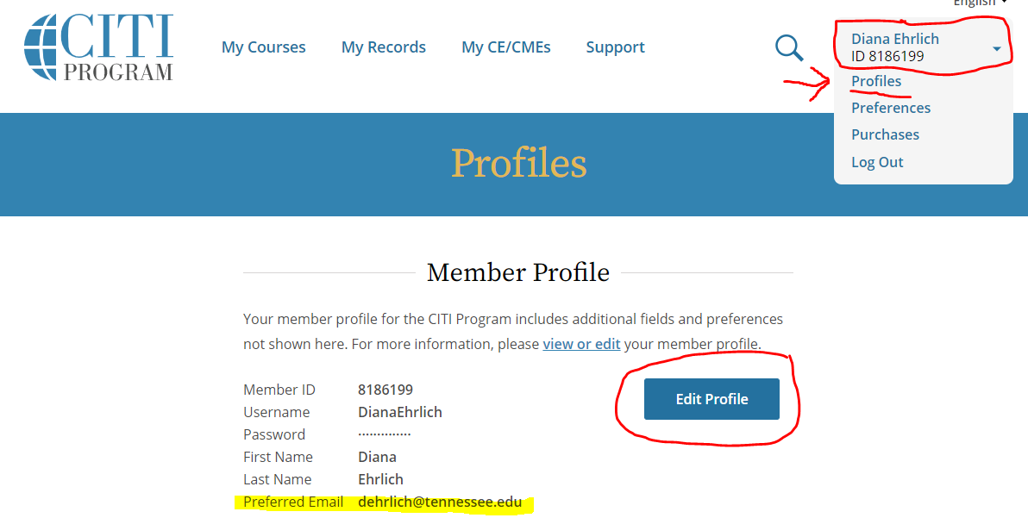
Research Agreements- Regulatory Compliance
To ensure that a PI or other Key Personnel have documented their most current CITI training for Research Compliance purposes, it is necessary to associate your CITI training account with your NetID@Tennessee.edu e-mail address. If another address is used, including UTHSC, it will not register new/updated trainings in the Research Registration system.
To verify, log into your CITI training account and edit if needed:

Slide 38

Questions?

Slide 39
Office of Sponsored Programs- Contacts​
Sarah White ​
Associate Vice Chancellor for Research ​
swhite82@uthsc.edu​
Phone: 901.448.2359​
Brenda Murrell
Director, Proposal and Award Management​
bmurrell@uthsc.edu ​
Phone: 901.448.4889
Research Agreements
Operations
Pre-Award
OSPcontracts@​uthsc.edu
egrants@​uthsc.edu
Cassie Watson, JD
Assistant Director of Research Contracts
cwatson@uthsc.edu
901.448.2063
Diana Ehrlich, JD
Assistant Director of Operations
dehrlich@uthsc.edu
Phone: 901.448.1283
Claire Ashbrook
Sponsored Programs
Administrator​
cashbroo@uthsc.edu
901.448.1877
Michelle Lester
Sponsored Programs
Administrator
mlester@uthsc.edu
901.448.2037
Notes:
Do we want to reiterate the process here- so Dept. Admins review first? How do they sent them to us- do we want to promote a uniform submission method for review? Cayuse? Egrants?
If not I can delete this slide

